Slide 1
CAHAM 50TH CONFERENCE San Francisco, California
Authorization and Verification of Benefits - Validity and Effectiveness, a Legal Perspective
August 28, 2018
Stephenson, Acquisto & Colman
303 North Glenoaks Blvd. Suite 700
Burbank, CA 91502
Office: (818) 559 - 4477
Fax: (818) 559 - 5484
SACFirm.com

Slide 2
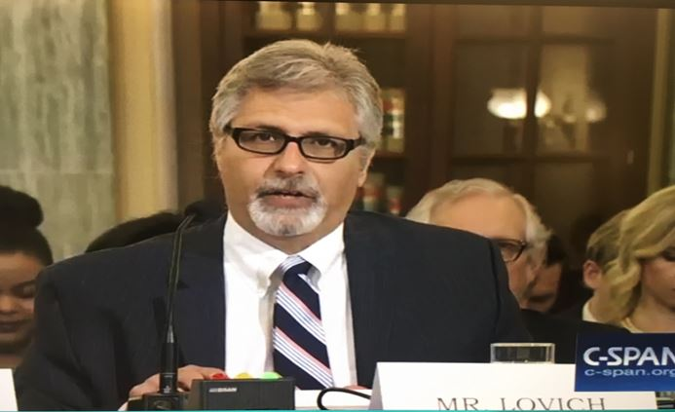
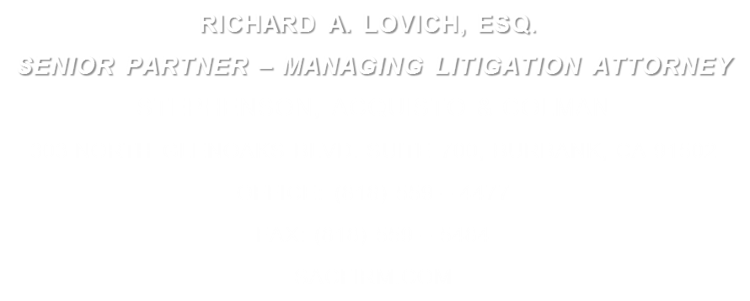

Slide 3
Mr. Lovich is SAC's Managing Litigation Attorney. He is responsible for litigation management and trial readiness of all cases from the pre-litigation stage through trial or arbitration.
Mr. Lovich has over 30 years of litigation experience including 15 years as the chief trial lawyer and managing attorney for the Los Angeles law offices of two of the country’s largest insurance companies.
National Legal Counsel to the American Association of Healthcare Administrative Management (AAHAM).
National Association of Distinguished Counsel-Nation’s Top 1 Percent.
Martindale-Hubbell Preeminent A-V rating, the highest possible, for 21 years.
"Southern California Super Lawyer".
Named as a Top Rated Lawyer-Healthcare in the October 2012 issues of Corporate Counsel and The American Lawyer magazines.
Certified National Institute of Trial Advocates (NITA) instructor, responsible for the development, implementation, and presentation of national trial advocacy training programs

Slide 4
AUTHORIZATION
REQUIREMENT
CONTRACT BASED
EXTENT IS CONTRACT SPECIFIC
CONFLICT WITH TELEPHONE INFORMATION
RAMIFICATION OF A LACK OF AUTHORIZATION

Slide 5
OVERVIEW
ULTIMATE USE OF ADMISSION INFORMATION
BILLING
ESTABLISHING RIGHT TO RECOVERY
LAWSUIT
ARBITRATION
ALJ HEARING
MEDIATION
MEET AND CONFER

Slide 6
AUTHORIZATION
TYPICAL AUTH CALL
DISCLAIMER-IMPACT
INDICATION NO PRE-AUTH NEEDED
REFERENCE NUMBER vs. AUTH NUMBER
LIMITATIONS ON AUTH

Slide 7
VERIFICATION OF BENEFITS
AUTH + VERIFICATION
PREPRINTED CHECK LISTS-GOOD AND BAD
HELPS IN COVERING ESSENTIAL AREAS
CAN BE FATALLY LIMITING-FIT IN BOX
RECORDED
REASONABLE AND CUSTOMARY USING WHAT BASE?

Slide 8
VERIFICATION
BAD INFORMATION- IMPACT ON RECOVERY
INFORMATION COMMUNICATED BEFORE SERVICES RENDERED
SERVICES PROVIDED IN RELIANCE ON BAD INFORMATION
OUTDATED WEB SITE INFORMATION
TPA LATE NOTIFICATION
SUBSEQUENT DENIAL OF ELIGIBILITY

Slide 9
VERIFICATION
PATIENT AS A SOURCE OF INSURANCE INFORMATION
INSURANCE CARD
VERBAL COMMUICATION
INTENTIONALLY MISLEADING THE PROVIDER
INVESTIGATION
NOTIFICATION REQUIREMENTS

Slide 10
ASSIGNMENT OF BENEFITS
MEANING
IMPACT
USE OF AOB FOR AND AGAINST FACILITY

Slide 11
DANGER ZONE
ADMISSION DOCUMENTS THAT MAY CAUSE PROBLEMS

Slide 12
CONDITIONS OF ADMISSION
“This hospital maintains a list of health care services plans with which it has contracted. A list of such plans is available from the financial counseling office. The hospital has no contract, expressed or implied, with any plan that does not appear on the list. The undersigned agrees that he/she is individually obligated to pay the full cost of all services rendered to him/her by the hospital if he/she belongs to a plan which does not appear on the above mentioned list.”

Slide 13
EFFECTIVE DOCUMENTATION
THE KEY TO SUCCESS

Slide 14
INTRODUCTION
Purpose of documentation
Be Complete
Be Accurate
Show each step in the story

Slide 15
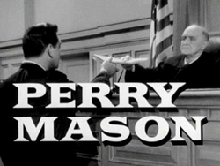
Prove it all night
What if you had to prove every thing you did happened in a particular way?

Slide 16
Perry white

Slide 17
Five w’s and an H
Who
What
Where
When
Why
How

Slide 18
Who:
Name – First and Last
Telephone number/extension
Job title
Supervisor’s name

Slide 19
What:
Purpose of the call
Specific Issue
Clear & Complete

Slide 20
Where:
Where did you call? Blue Cross?
Number
Extension

Slide 21
Where:
Address to which documents were sent
Full Address
Recipient
Content
Method of Transmittal
Reference Number

Slide 22
How:
Method of Transmittal
Fax, Email, Snail Mail
Include Cover Letter
Fax Cover Sheet
Complete cover letters & cover sheets to document what was sent

Slide 23
Why:
Purpose of the call
Collection
Authorization
Verification

Slide 24
ACCURACY

Slide 25
ACCURACY
You only get one chance to make a first impression
The validity of the documentation is key
Judges have to believe you
Incorrect information kills credibility

Slide 26
ACCURACY
Verifying everything you can
You are being documented

Slide 27
BE COMPLETE
Include fax cover sheets & cover letters
Document what was sent in cover letters & fax sheets
Document who it was sent to & how

Slide 28
THANK YOU!

