Slide 1

The Millennial Mindset
Facilitator: Daniel Stover

Slide 2
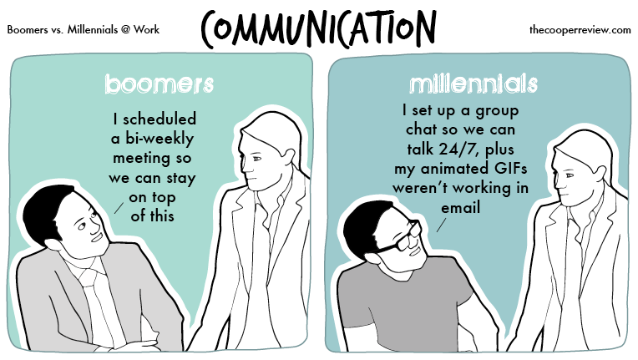

Slide 3
Define the Problem…
What are your biggest challenges interacting with young team members?
How do you usually handle those challenges?
What could you do better or differently when leading them?

Slide 4
Troubled Egos
“The young people of today think of nothing but themselves. They have no respect for their parents or age. They are impatient of all restraint. They talk as if they alone know everything, and what passes for wisdom in us, foolishness in them.”
Notes:
Peter the Hermit, 11th Century, AD

Slide 5
Troubled Minds
“The free access which many young people have to entertainment has poisoned the mind and corrupted the morals of many promising youth; and prevented others from improving their minds in useful knowledge. Parents take care to feed their children with a wholesome diet; and yet how unconcerned about the provisions for the mind?”
Notes:
Reverend Enos Hitchcock, Memoirs of the Bloomsgrove Family, 1790

Slide 6
Troubled World
"There they are, those preening narcissists who have to document every banal moment with their cutting-edge
communications technology.”
Notes:
Newsweek, December 30, 1985: "The Video Generation.

Slide 7
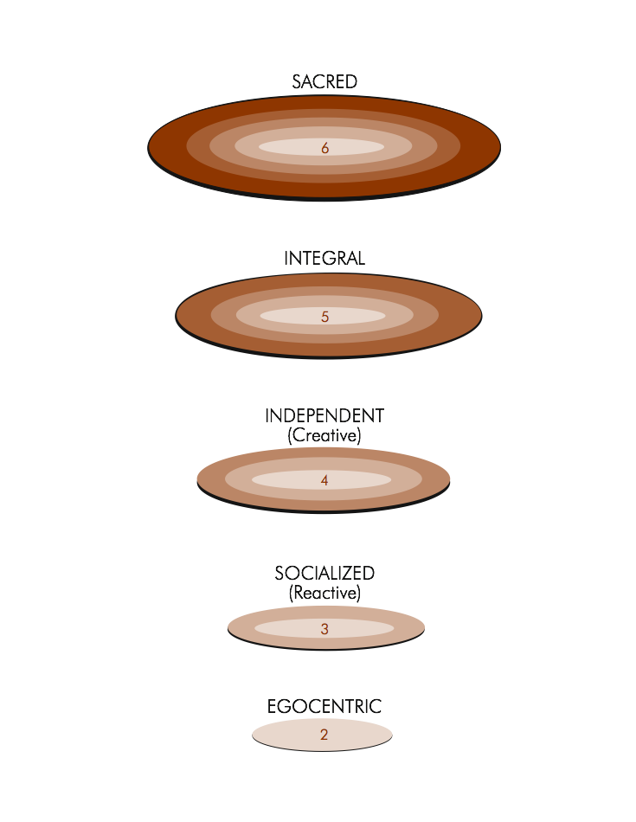
Levels of Adult Development
6 – Sacred
Few achieve this.
5 – Integral
1% achieve this.
4 – Independent
19% achieve this.
3 – Reactive
80% achieve this.
2 - Egocentric
Leadership
starts above
this line.
This diagram is based upon the research of Robert Kegan, Ph.D.
Notes:
A fully formed adult is someone who is serious about their life and their career and what they want to contribute. You can have fully formed adults in their 20s all the time, and there are plenty of not fully formed adults in their 40s and 50s—and we work with them every day. Patty McCord is the former head of HR at Netflix

Slide 8
What Millennials Look For in a Job
Opportunity to learn and grow
Quality of the boss
Quality of the company leadership
Interest in the type of work
Opportunity for advancement
Notes:
Source: Gallup, published by HBR

Slide 9
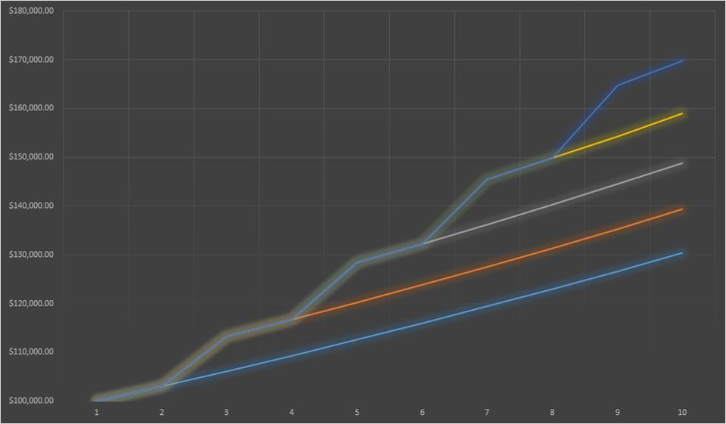
So Why Do They Jump?
Notes:
Source: Forbes
Straight lines are a 3% annual raise, staying with the same company.
Jotted lines are a 10% increase in salary by switching companies every 2 years.
Conservatively, by changing jobs in the current economy, young people stand to have a $50,000 annual increase in salary over 10 years.

Slide 10
Shifts in Thinking
A
B
C
D
Activating event Belief Systems Consequent Emotions Dependent Behavior
Example:
Dan offers his opinion, unsolicited, for the fifth time this meeting.
Dan offers his opinion, unsolicited, for the fifth time this meeting
Dan has no respect for what we have already done.
Dan has no respect for authority.
**New Belief**
Dan has a lot of ideas he feels he needs to share.
Dan does not realize his opinions can be disruptive and off-topic
Anger
Frustration
Annoyed
Disrespected
Resentment
Curiosity
Acceptance
Concern
Shut Dan down.
Publicly dismiss Dan.
Avoid talking to Dan.
Discuss Dan’s ideas with him privately and coach him on appropriateness of timing when contributing to the conversation.

Slide 11

Tips for
Managing all Generations
Accountability
  How? Assertive conversations, clarity, written policies, multiple deadlines to produce results. Praise them specifically and give them regular feedback (quarterly reviews) and small rewards along the way.
Empathy
  How? Give the benefit of the doubt. Make positive assumptions about what drives their behaviors (ABCD). Seek to understand and approach with curiosity not resentment.
Understanding
  How? Get to know them, their interests, and their passions. Keep an open mind to what value their differences might bring to the organization. Offer explanation when differences of opinion arise.

Slide 12
Tips for
Engaging Millennials
Career Coaching
  How? Discuss career path with employees. Create paths with timeframes short enough for them to envision. Set short-term goals. Ask questions to help them learn culture/political savvy. Give ongoing positive and constructive feedback.
Provide Learning/ Training Opportunities
  How? Provide tuition reimbursement, put them in charge of a charitable event, consider job shadowing, have brown bag lunches where different departments share information. Share articles, books and information with them. Have them track their own progress and share their measurements with you.
Allow for Creativity/ Flexibility
  How? Let them figure things out/ do it their way, tell them the why behind the what, give several different projects, let them work in teams, let them work with higher ups when appropriate.

Slide 13
Looking for more?
Daniel L. Stover
Senior Leadership Consultant
Integrated Leadership Systems
Los Angeles, CA
dan@integratedleader.com
213-986-7193
www.linkedin.com/in/dlstover
www.integratedleader.com

