Slide 1

CAHAM Eligibility Boot Camp - 2014
Ana Gonzalez, CEO and Advocate
Diversified Healthcare Resources
By diversifiedhealthcare.org

Slide 2

Learning Objectives
Satisfying little breakthroughs
ACA
Understand its affects post ACA
Top Eligibility Challenges
What are the pieces causing confusion
Eligibility Overview - I
Understand MAGI Medi-Cal and non-MAGI Medi-Cal
Eligibility Overview – II
Learn the values of pursuing other eligibility programs
Staying Insured
Learn of the opportunities to help stay insured
Open Discussions
Open for case reviews or questions

Slide 3

Lets have fun…

Slide 4
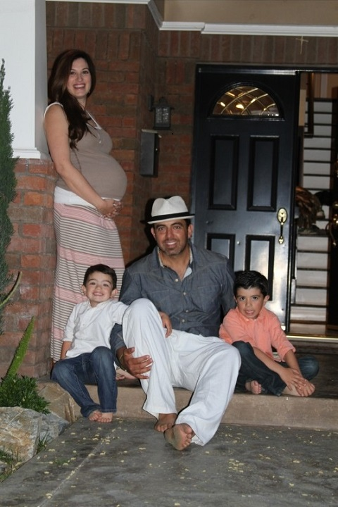
Eligibility Scenario
Maria is lovely lady, 40 yrs old, just diagnosed with terminal breast cancer. What program(s) would you recommend and why? She does not want a high share of cost and does not want to spend her assets.
Household: Maria and Husband (citizens)
3 minor children under 18yrs
Income: Self-employed janitors
Feb income: $8,000 Mar income: $7,000
Apr income: $7,000
May income: $7,000
Jun income: $5,000 (summer)
Jul income: $4,000 (summer)
Aug income: $4,500 (summer)
Assets: $60,000 Maria’s retirement

Slide 5
Affordable Care Act (ACA)
2013
Expand health coverage to all
California was an early adopter of the ACA and has been a leader in enrolling eligible residents in coverage through the two main avenues for expanding coverage under the law:
  Medi-Cal
  Covered California, the state’s marketplace where people can shop for insurance and access government subsidies to help pay for coverage.

Slide 6
Sounds easy right?
Well….that’s when the puzzle craze began
Covered California
MAGI Medi-Cal
Non MAGI Medi-Cal
Hospital Presumptive Eligibility (HPE)

Slide 7

Here’s the Result of ACA as of June 15, 2014
Source: Kaiser Family Foundation Panel Survey April-June 15
Of those Californians who were uninsured prior to open enrollment
  58% now report having health insurance, which translates to about 3.4 million previously uninsured adult Californians who have gained coverage
  42% say they remain uninsured.
  25% of previously uninsured Californians reporting they are now covered by
  Medi-Cal.
  9% of California’s previously uninsured say they enrolled in a
  plan through Covered California
  12% say they obtained coverage through an employer and
  5% report enrolling in non-group plans outside of the
  Covered California Marketplace

Slide 8
Sources of Coverage – Previously Uninsured
58% Newly Insured
42% Remain Uninsured

Slide 9
Self Pay Trends
Expert Predictions…get ready to keep them insured!

Slide 10
Phases of the Newly Insured
HAPPY
UNFAMILIAR
RISK
Annual redeterminations
DHCS and health plan paperwork
10 day report of changes

Slide 11
Eligibility and Enrollment Challenges
Challenge #1 – Covered California CalHeers Website and county backlogs
Challenge #3 – HPE Misunderstandings
Temporary 2-month benefit period – need to apply for ongoing permanent benefits separately
CalHeers errors ~ Lost applications ~ High backlog still existing
14 digit Temp ID # must be used for billings made under this temporary period
Challenge #2 – County’s Lack of Training
Delayed applications ~ CalHeers and Meds interface issues ~ deprivation ~ retroactive coverage to cover month of application
Doctors, clinics and pharmacies are unaware of HPE (must use temp 14 digit number until permanent BIC# is issued)
Full scope benefits for 2-months only (do not prolong the work of the county workers for extended temp benefits, do it right!)

Slide 12
Eligibility Overview I – Medi-Cal (new and old)
MAGI Medi-Cal vs. non-MAGI Medi-Cal
Income 0-138% FPL
Income above 138% FPL
Under 21
Uninsured
MAGI
Non-MAGI
Adults 0-138% FPL
Children 0-266% FPL
Exempts all assets
Ages must be 0-64 yrs
Not enrolled in Medicare
Disabled
Families w/children in the home
Pregnant
Confined to Skilled Nursing
Medicare
Asset limits
No income limit
Over 65
Certain cancers
Blind
Pregnant 0-213% FPL
Income by family unit
Income based on Tax Return

Slide 13
Hospital Presumptive Eligibility (HPE)
A temporary benefit program for the MAGI eligible only
Hospital must enroll for participation
Program started January 1, 2014
Online portal for immediate determinations
Provides temporary FULLSCOPE - no Share of Cost Medi-Cal
Patients must be getting services from or being admitted
Hospital must agree to terms and conditions
    100% of HPE enrolled patients must receive a Medi-Cal application
    95% of HPE enrolled patients must receive a copy of their temp ID and copy of signed HPE application
    Maintain record of key benchmark dates
Determination is based on income self-attestation, household size, state residency requirements
Can only get temp benefits once every 12 months, except for pregnancies. One benefit period allowed for every pregnancy.

Slide 14

Eligibility Overview II
Other healthcare benefit programs to consider if no linkage
Medi-Cal Disability
Medi-Cal 250% Working Disabled
Specialty Programs
  BCCTP
  ESRD
  TPN
Social Security Disability
California Children Services
Prostate Cancer IMPACT
GHPP
County Programs
  CMS
  MSN
  CMSP etc
Victim Compensation Program (CalVCP)
  Insurance co-pays
  Medical and dental treatment
  Mental health services
  Income loss
  Funeral/Burial expenses

Slide 15
Lets have fun…lets see what you’ve learned

Slide 16
Income: Self-employed janitors with net income on tax return reported at $46,000 for prior year and income is decreasing
Did not want to apply for Medi-Cal due to high SOC; here were the alternatives
INCOME: POTENTIAL PROGRAM
Feb $8,000 Medi-Cal 250% Working Disabled ($200 approx)
Covered Cal (Silver Anthem $224, Bronze $13)
Mar $7,000 -same as above-
Apr $7,000 -same as above-
May $7,000 -same as above-
Jun $5,000 (summer) Medi-Cal 250% Working Disabled BCCTP (looks at gross income)
MAGI Medi-Cal (looks at net after business expenses)
Jul $4,000 (summer) BCCTP
Aug $4,500 (summer) BCCTP
Assets: $60,000 Maria’s retirement account

Slide 17


Opportunities to Stay Actively Insured
Designate someone to keep you informed, be ahead of the curve.
-Join an eligibility information task force that keeps you informed
Don’t forget all the other benefit programs, no temp short cuts!
-Plan initially for ongoing coverage and assess for PRUCOL status
Educate your department, coworkers and patients
-Seek for ongoing permanent benefits, not just the temporary benefits
-Make sure to re-emphasize the importance of completing paperwork timely

Slide 18
Educate and be wary of temporary P aid codes
-Inquire and validate expiration date and confirmation that a full
Medi-Cal was submitted
Coordinate with your vendor partner to assure that the patients
remain insured and offer assistance with annual redeterminations
Work with local Long Term Care facilities to proactively discuss
barriers and opportunities relating to patients being transferred with
P benefit aid codes
-Get involved at case managements’ monthly/quarterly meetings

Slide 19

Ana Gonzalez
Like a puzzle, there are those who construct them and those who solve them.
Together, our different minds we can make things happen.
Success!
(714) 772-4034 Office
(415) 446-8116 Cell

