Slide 1
Paving the Way for Positive Patient Experience through Financial Clearance
Becky Peters
System Director, Patient Access Services
Sutter Health

Slide 2
Objectives
Learn how to build an Patient Friendly and Focused Financial Clearance Program through:
Centralized functions and standard processes
Developing a Positive Employee culture that puts the Patient First
Creating a Learning Environment that Engages and Empowers staff
Agenda:
Moving to an Enterprise strategy
Our journey toward understanding what it takes to create a Positive Patient Financial Experience across the System
How we create collaborative partnerships with credible internal and external groups to develop staff, and spark passion in the workplace
Notes:
How do you build a operational infused education program
Create a learning program that addressing a large audience in multiple settings.
How to position for growth – go to market and sell and doing this by building library of courses/career paths.

Slide 3
Sutter Health at a Glance
27 Acute Care Facilities across Northern California & Hawaii
Facility Beds:5,000
Births: 35,498
Discharges: 206,804
Emergency room visits: 798,681
Outpatient visits: 10,310,82
Physicians (members of Sutter Medical Network) 5,000

Slide 4
A little bit more about us…
Sutter Health’s Mission:
“We enhance the health and well-being of people in the communities we serve through a not-for-profit commitment to compassion and excellence in health care services.”
Notes:
LB

Slide 5
Workshop Dialogue
Do you have centralized or de-centralized Financial Clearance functions?
How does your pre-service team communicate with point of service registration or check-in?
What challenges do you experience between pre-registration and point of service registration or check-in that create a positive or negative patient experience?

Slide 6
Our Patient Financial Experience Journey
Historically
Today
Lack of trust
Low collections
FastTrack
Quality Audits
Clean hand-off’s
real time Eligibility/
Benefits
Inaccurate estimates
Real time Reg Quality
Variance redundancy
Accurate estimates & improved cash
Long wait times
Educated Patients-no surprises
Standard & streamlined workflows
Surprise, you owe…
Labor-intensive
Notes:
At Sutter Health we take the patient experience serious and consider every touch point an opportunity to create a high quality experience. Prior to leveraging the many tools Experian has to offer, patients had a completely different and very disconnected experience when it came to billing and liability. There were severe delays in the time it took for patients to receive there bill, we either did not have estimates or estimates were labor-intensive requiring staff to do significant amounts of research. Patients would call in for benefit information and depending on who they spoke to would receive a variance in responses. Estimates were primarily based on total charges, not the patient’s liability. We only accepted cash or check at point of service and our request for payment was often met with a response like, “I left my wallet/checkbook at home”, “ I didn’t want to bring my purse to the hospital while I was in surgery”. Wait times on applications were long and required supporting documentation. And worst of all, patients didn’t find out what they owed until they got the bill in the mail…months later! So, at Sutter we made a decision to create not only a great patient experience during your hospital stay or clinic visit, we invested in Experian’s suite of tools that supports the culture we wanted to instill. Today we have timely, quality billing. Our Foundation has a patient facing portal and we have a shopper estimate call in group. E-Benefit information is imported into our EHR. Estimates are based on benefits, contract rates, and outstanding patient liability. We collect payments securely and electronically over the phone. We offer immediate, real-time financial assistance. And most importantly, our patients have an increased understanding about their benefits and liability that helps them make educated decisions- they have the whole story ahead of time!

Slide 7
Moving from a Individual/Regional perspective to a Enterprise Wide Strategy
Epic go lives
MPHS 4/2009
CVR 10/2011
PCR 12/2011
Eden 12/2012
Delta 3/2013
ABSMC 4/2013
CPMC 11/2013
Novato/Lakeside 2/2014
Santa Rosa 10/2014
SSR 1 2/2015
SSR 2 8/2015
Coast 3/2016
Currently on Single Episode Epic version 2015 and upgrading to 2017 in October 2017.
Notes:
SR

Slide 8
Sutter Shared Services (S3) Revenue Cycle 2013 Opening
Removing the Barriers for Collaboration, Best Practices and Standard Work
Patient Access Services
Central Billing Office
Health Information Management
Revenue Cycle Integration
Revenue cycle Liaisons
PMO
Revenue Integrity
Education and Training
Data Analytics

Slide 9
Sutter Health Patient Access Services
Patient Access System Director
Revenue Cycle Education and Training
Patient Access Center Director
S3-PAC
Patient Access Regional Director-Valley
Patient Access Regional Director-Bay
PAS Facility Managers
PAS Facility Managers
Central Scheduling
Financial Clearance & Counseling teams
Patient Access Services
Central Scheduling
Pre-service Financial Clearance &
Financial Counseling
Point of Service Registration
Cashier
PBX
Patient Advocates
Revenue Cycle Education
Quality Analysts
Data Analytics

Slide 10
Sutter Health Patient Access Vital Few Strategies
Deliver an excellent, standard and streamlined patient experience
Utilize LEAN Philosophy for continuous process improvements, standardization and employee engagement
Innovative Technology and Data Analytics
Collaborative partnerships with our Customers
Focused, relevant & measurable education/training
Staff Engagement and Satisfaction

Slide 11
Collaboration Improves Patient Experience
What we do
Improvement for the Patient
Seamless handoff from PAC to POS (Learning to trust)
Complete and accurate financial clearance includes: preregistration, insurance eligibility, benefit verification and review, authorization, patient liability explanation and collection (including price estimates)
Financial Counseling when needed for; Payment Plans, Financial Assistance/Charity and VIP referrals for Government eligibility assistance
Use standard documentation and real time E.H.R reports that POS can see (DAR) and understand what conversations and/or actions have taken place with the patient prior to arrival
Set expectations for the patient when they arrive at the hospital for their services
Provide them wayfinding instructions and parking
Standard scripting, tools and roles both in Pre-Service and Point of Service teams.
Reduces unnecessary rework- Patient confused and frustrated when we ask the same information multiple times (ex: why do I have to register again here when I already preregistered over the phone?)
Ability to bypass long waits for registration and go directly to the service department (Fast Track)
Has been educated on Patient Liability and provided options that work best for their situation (No surprise bill)
Authorization’s secured prior to service so no unexpected delays or cancellations
Consistent messaging and processes no matter where they receive services
Reduction of billing errors & denials

Slide 12
Patient Access Center Top 10 Best Practices
Conduct real time insurance verification/eligibility/benefits review
Utilize real time Patient Price Estimations and collects patient liability prior to and at point of service
Performs real time registration quality reviews and corrections
Employ RN’s as Clinical Liaisons to partner with physicians and insurance companies for authorization and medical necessity issues
Financial Counseling unit within PAC to assist patients that need additional options; payment plans, real time charity review/approvals, follow up on post discharge IP authorizations, shopper price estimations, TARS, etc.
Utilize a third party vendor for MediCal and other program eligibility identification and application process during pre-service and Point of service.
Record and monitor all inbound/outbound phone interactions for Quality
Utilize Data and Analytics team to track performance and identify opportunity for improvements
New Hire Training program /on going competency checks/education
Interactive workflow and scripting tool available to all staff

Slide 13
Patient Access Point-of-Service
Personable and Efficient Patient interactions
Clear indications of what information is needed from patient
Fast Track check at Service departments based on Pre-Service Financial Clearance
Onsite Patient Advocates for non-scheduled/urgent patients
Price Estimates
Collections
Payment Plans
Financial Assistance/Charity
Onsite Vendor support for government eligibility assistance and payor discovery
Expanded coverage in Emergency departments and 7 day a week support
Utilizes same tools and workflows for process transparency and standard work
They see all touch points that the S3 PAC staff had with the patient
Access to Patient Estimation tools
Registration accuracy gap stop with additional edits
Provides account escalation support
Continues patient and physician communication for late-add-on scheduled procedures
Liaisons with scheduling departments for on-going patient experience improvements

Slide 14
Quality Auditing
Registration Quality Audit –tool that provides registration accuracy identification and correction flags for real-time error resolution
Tracks Top 10 errors by facility/user
Individual & Facility Score Cards
Integrated single source tool
Payor Plan Mapping/Bad Plan flags
Denials root cause team
Training Analysis protocols and monitoring
Phone monitoring and scoring software
Customer service, process adherence and compliance score card
Desktop recording to ensure information captured is accurately documented in the account record
Phone monitoring and recording used for weekly audit and employee coaching

Slide 15
Providing your Team with the Right Tools at the Right Time
E.H.R-Epic, System wide
Third party Platform
Insurance eligibility
Address checker
Real time Charity care assessment/application
Bad Plan Flag Indicator
Integrated Real time Quality-Registration Accuracy
Payment posting
Real time Patient Price Estimator
New-Automated hospital authorizations
Biometrics-Patient Identity
PAC Portal-Web Scripting Tool
Predictive Dialer
Process Automation-Robotics
Revenue Cycle Training/Education Portal

Slide 16
Patient Access Key Performance Indicators(KPI’s)- Patient Experience
Metric
Target
Patient Access Patient Liability Collections
HFMA Benchmark
35% of all Patient Liability collections\
Registration Accuracy
≥ 99%
Authorizations are in place prior to service for non-urgent/non-emergent patients.
95%
Abandoned Call Rate -S3 PAC
>3%
Average Call Wait Time-S3 PAC
30 sec
% of Accounts Financial Cleared prior to Service
98%
Notes:
Duration: 3 Minutes
Do: Describe the KPIs for Patient Access.
Say: KPIs for Patient Access are as follows:
98% of scheduled patients will be financially cleared within 24 hours prior to service. This helps in financially clearing the patients prior to service.
Calculation: Scheduled patients financially cleared 24 hours or more prior to service divided by total number of patients scheduled at least 24 hours prior to service.
≥ 98% of admits (inpatient) for emergent cases will be financially cleared within one business day. Both these SLAs ensure that emergency room patients are financially cleared.
Calculation: Emergent inpatient admissions financially cleared within one business day divided by total emergent inpatient admissions (admissions through Emergency Room).
≥ 98% of required registration data elements are complete and accurate. This ensures that the registration data elements are complete and accurate.
Calculation: The number of pre-registered accounts with complete/accurate registration data elements divided by total number of accounts pre-registered.
≥ 98% of authorizations are in place prior to rendering of services for non-urgent/non-emergent patients.
Calculation: Number of required authorizations in place prior to or on service date divided by total number of required authorizations for non-urgent/non-emergent services.
≥ 95% of scheduled uninsured and underinsured patients that are unable to make payment or payment arrangements are screened for financial assistance prior to service.
Calculation: Number of scheduled, uninsured and underinsured patients that are unable to make payment or payment arrangements are screen for financial assistance prior to service divided by total number of scheduled, uninsured and underinsured patients unable to make payment or payment arrangements.
≥ 95% of unscheduled uninsured and underinsured patients that are unable to make payment or payment arrangements are screened for financial assistance within one business day post service.
Calculation: Number of unscheduled, uninsured and underinsured patients that are unable to make payment or payment arrangements are screened for financial assistance within one business day post service divided by total number of scheduled, uninsured and underinsured patients that are unable to make payment or payment arrangements.
Let’s check your understanding of the topics covered in this module.

Slide 17
Workshop dialogue
Do you have a training program and dedicated trainers?
How do you deliver training to staff?
How do you engage your staff in improving the Patient Experience

Slide 18
PAS: Our Purpose
“To build and foster an innovative culture that promotes: Trust, Respect, Collaboration, Understanding and Success for our Patients, Staff and Customers

Slide 19
Investing in our Human Capital
Employee driven decisions
Staff Roundtables & 360 Feedback
Communication-Take 5
PAC portal
Job shadowing program-Rev Cycle
Career Networking event
Employee Recognition programs-
PAC Culture Committee, STAR Program, Thank you Thursdays
Empowering and engaging employees
Career development tracks
Education Program-RevCycle U
Lean Training/Certification
Experience of Work (EOW)
Notes:
Trainers infused in the operational teams.
Our employees are our most valuable asset. The skills or education they come into our organization help add immediate value by filling a gap or solving a problem. The skills our staff have today may not be the skills we desire in the future. Therefore, the training and experience we give our staff is an integral long-lasting. The investment we make in our employees will get us to our vision and goals better and faster.
We put the employee in the driver’s seat and ask them what they want to learn and how they want to learn it. Through regular Experience of Work round tables and other forums we capture ideas and implement them timely. We encourage our team members to be creative and come up with better processes such as the PAC portal. This was an employee owned project that has been a game changer. 2 employees developed a dynamic scripting tool that has become a standardized best practice approach to cash collections. PAC and CBO team members have started to job shadow. This program gives team members a chance to see the upstream and downstream impact of their work. Team members hold a debrief session afterwards to discuss what they learned and any opportunities to improve. Recently, we offered HBI’s eLearning Medical Terminology course to our Central Scheduling team members in an effect to increase their knowledge around this topic. Employees thought it would help them review charts and schedule templates more efficiently. This course is now going to be a requirement for any new scheduling staff.

Slide 20
Building a Team that puts the Patient First “What if I and What if We”
Assume Positive Intent
Embrace New Ideas and views
Be open to giving and receiving Feedback
Be willing to look at things from a different perspective
Walk in another’s shoes
Get out of your comfort zone more often
Share histories to break down barriers
Cultivate understanding-ask Why
Embrace success as a Team- not always about the individual
Take Risks- don’t be afraid to fail
Practice an Open Mind
Be Respectful in all things
Trust
Seek out collaboration
Dream Big & Share

Slide 21
Pioneers of Change
Video- Employee Engagement
https://sutter.jibecast.com/external/video/8e856eba6231be347a5dc7f899b309ee

Slide 22
2017 RC Education Program Structure
Designing Our Program Structure
Blended Learning Model
Revenue Cycle Overview
Curriculum ownership and structure
Coding School
Rev Cycle U Portal
Notes:
SR
We looked at where our training started, identified the gaps and what wasn’t working, and have built our training materials based on where we want to go as a learning department. Reviewing our learner feedback, partnering with the business owners to identify the scenario and workflow needs, and looking at trends in training development has helped us make significant improvements to the trainings and materials we offer.
Building out competencies – NEO and Career Ladder
Our training has moved to a blended learning model where we infuse technical and functional training for new hires.
We have developed a Revenue Cycle Overview course that is delivered in classroom, and developed an eLearning for remote work staff
Our EHR curriculum is now owned by our department instead of IS. This gives us more control over updates, edits, and scenarios.
Coding school launched in 2015 to offer staff who have an interest in Medical Coding the opportunity to be certified, and learn Sutter’s specific processes and standards for coding. This allowed us to reduce costs associated with vendor usage.
In 2017 we have launched Revenue Cycle U – a Learning portal designed to support our growing remote workforce and supports ongoing career development for Revenue Cycle staff.

Slide 23
Blended Learning Model
Epic Training Environment Structure
Curriculum Structure for New Hire Training
Revenue Cycle content development to support staff knowledge
Notes:
SR
We’ve made great strides to improving our instructional format to support the learning needs and styles of our users.
Epic Training Environment Structure:
Sutter has two separate pathways for our training environments: Current State and Future state. The Current State environment is connected to Production so that the build and current workflows are accurate.
Curriculum Structure:
We own our own Epic curriculum, and have integrated functional knowledge with technical training.
Revenue Cycle content development:
We have developed our own learning content to enhance the learning experience for our users, and made it accessible so that anyone can access the job role specific workflows.

Slide 24
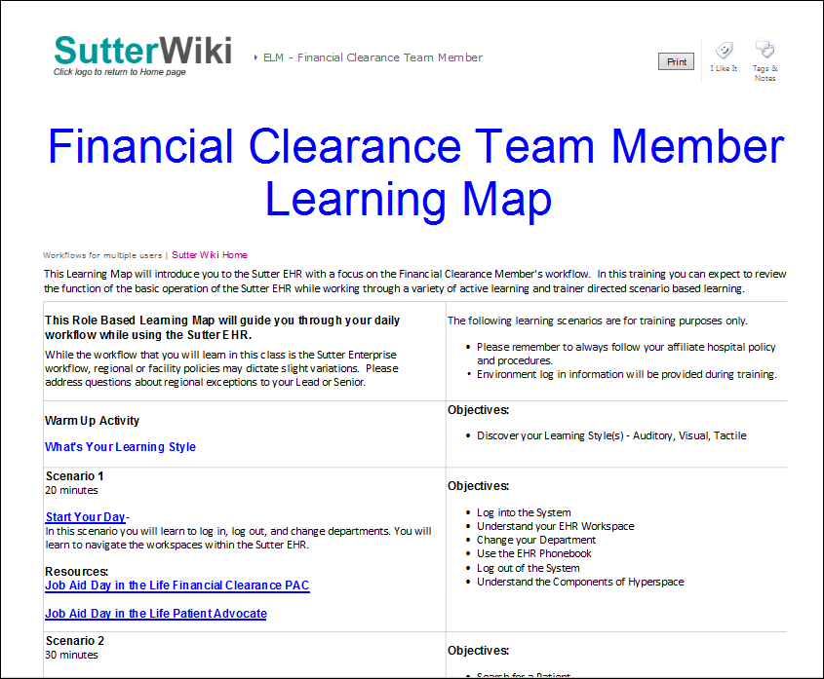
Integrated Functional and Technical Training
Curriculum Structure
Learning tracks specific for each job role through online Learning Maps
Scenario based learning
Integrate Job Aids into curriculum
Utilize standard Epic eLearnings
Notes:
SR
Curriculum lives online in a Sutter Wiki site – accessible for anyone in the enterprise at any time. Including when staff transition to production work.
The learning maps living on the Sutter Wiki provides the learner with class activates, learning objectives for the lessons, and additional resources such as Job Aids. We made the decision to link Job Aids into the curriculum, rather than building new curriculum pages, so learners become familiar with the actual resources they will use on the job.
Every learning activity starts with a scenario to provide context to the learning activity and follows best practice workflows.
We also utilize some of the Epic standard eLearnings are pre-learnings to instructor led content.

Slide 25
Partnerships are Key!
Round with Leadership, Team Leads, and Staff
Subject Matter Experts (SMEs) and Senior team members
Information System Analysts
Revenue Cycle Education Advisory Group
Notes:
SPayne
Round with Leadership, Team Leads, and Staff
This ensures training materials are consistent with current workflows. Team members attend huddles, quarterly leadership meetings, and perform observations with staff members.
Subject Matter Experts (SMEs) and Senior team members attend training
Involve SMEs and Senior Team members in training development and delivery. Leads and Seniors identify changes in workflow processes documented in Job Aids, email revisions to RCET for updates. SMEs and Seniors also may attend parts of the training session helps to educate staff on day-to-day operations. This includes instructing staff on how to use their scripting tools, phones, insurance information, patient estimates, and more.
Revenue Cycle Education Advisory Group
Invite RC Leadership to quarterly meeting to review key Education initiatives.
Information System Analysts
Key partnerships with IS Application Analysts

Slide 26
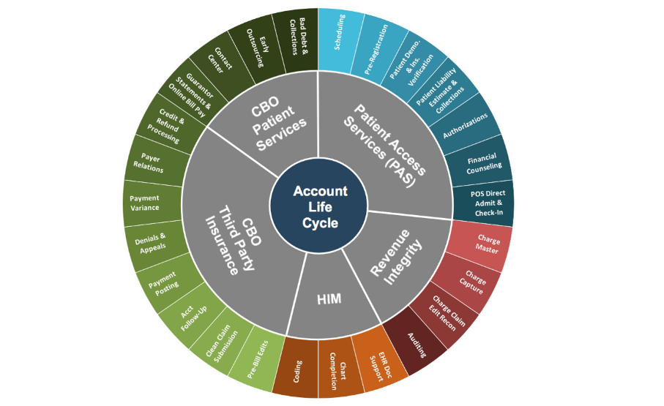
Revenue Cycle Overview
Benefits:
New Team Members understand that they are part of a larger process, including the notion that all Revenue Cycle Team Members impact denials and cash!
Level setting of metrics.
Face time with leadership.
Notes:
SR
New Team Members understand that they are part of a larger process, including the notion that all Revenue Cycle Team Members impact denials and cash!
Everyone in Revenue Cycle impacts denials and cash, not just the back end of the revenue cycle.
New hires see where their role fits into the big picture > there are downstream impacts.
Level setting of metrics.
Our Team Members walk away with an understanding of what AR Days are and how the metric is calculated. Additionally, we discuss how each of their roles has an impact on AR days.
Lastly, we’ve received feedback that new hires really appreciate face time with their VP. It’s a great way to welcome them to the company!

Slide 27
Revenue Cycle U Portal
Rev CycleU
Meet the learning needs of remote workforce
Expand our learning and delivery services to all facilities
Incorporate technology to promote learning
Support Career Development
Notes:
Spayne
In 2015 RCET engaged a consulting firm to develop a Learning portal for Revenue Cycle staff members. Using a Learning Portal to house our Learning and Development materials would support the creation of a best in class Revenue Cycle, and provide a central location for staff to access materials for their job role(s). The portal utilizes a Learning Management System platform that supports the RCET learning materials, and allows us to grow our vision of a Revenue Cycle University.
Meet the learning needs of our remote workforce
Expand our Learning and Delivery services to all Sutter facilities
Sutter has acute care facilities ranging from Crescent City down to Santa Cruz, which can be challenging for a centralized training team. Also, most staff only had intranet access to materials at their facility and could not access learning materials posted through Shared Services or outside of their service area. The Portal allows us to expand our learning reach to all facility based staff performing Revenue Cycle functions with minimal impact on training resources. RCET controls the access to the Portal and there are no restrictions by facility or service area. It is one centralized location that all RC staff can use to access job aids and resource for their roles and workflows.
Incorporate technology to promote learning
We want to be innovative with our training delivery and leveraging new technologies will help us achieve that, as well as build our Rev Cycle U vision. The Portal has the capability for Gamification where staff can earn badges with the points earned. Our newsfeed allows us to update staff on new Projects, Job Aids, Epic Upgrades, and other news that may affect their day to day. The Streaming section supports Videos and Podcast for Revenue Cycle, and we’ve published our first Cash Collection video and Rev Talk with our VPs. Staff can rate job aids to provide feedback on the job aids that are helpful, and what may not be current. In the future there is the potential for mobile learning and utilizing smart phones and tablets.
Support Career Development
Based on Experience of Work (EOW) survey feedback from staff it was identified that additional material and classes were needed to support career development. The Revenue Cycle U allows us to post eLearnings, Resources, and courses for all members of the Revenue Cycle to access. This allows staff in one service line to explore another area to discover if their skill set may be a better fit. Our team has conducted the SHINE Series which focuses on providing Revenue Cycle Management and Senior staff the opportunity to improve and grow their management skills.

Slide 28
Innovative Education
Good To Great
We fully expect our innovation and determination to result in a World-Class customer service operation with empowered and committed employees producing strong financial performance and sustainable long-term growth.
eLearning Modules
Career Mobility Tracks
Virtual Classrooms
Centralized DTP’s/Job Aids
Push/Pull Content
Video Library
Self-service Learning
28
Notes:
With a growing remote workforce and the need to meet learners from all generations where they are we are designing and implementing a learning platform that will consist of…career mobility tracks, eLearning modules, gamification, push/pull content, desktop procedures and job aids, self-service learning and a video library all in one place.

Slide 29
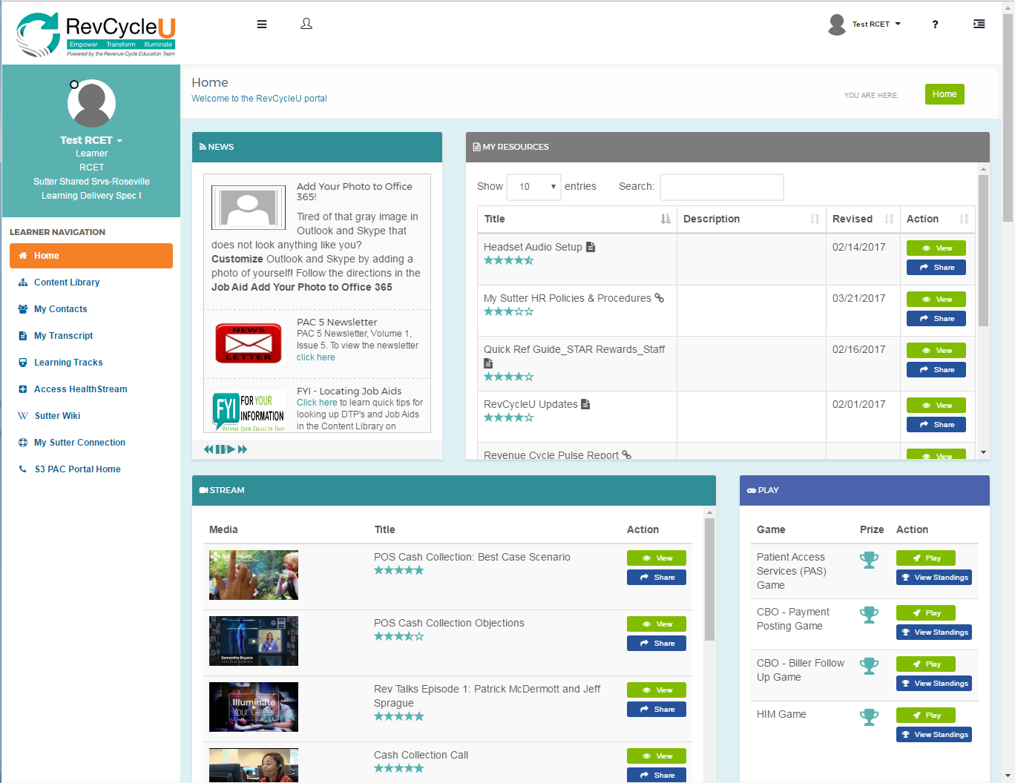
Notes:
SPayne

Slide 30
Becky Peters
Patient Access Leader, System Director
PetersBA@sutterhealth.org

