Slide 1

“the fast and the Furious”
Revenue Cycle - 3.0
(a.k.a.) The Revenue cycle of the future

Slide 2






Industry analysis
82% of people say price is the most important factor when making a healthcare purchasing decision*
The costliest 1% of patients in the US consume 20% of the nations healthcare*
11-20% of Americans think healthcare is affordable*
Percentage of covered workers enrolled in a plan with a deductible of $1000 or more is on the rise* (i.e., 46.0%)
43% of patients in fair or poor health found medical treatment unaffordable**
In 2015 25% of employers are only offering high deductible plans**
Source: *Price Waterhouse Copper HRI Consumer Survey 2014
Source: **Money Matters Billing and Payment For A New Health Economy

Slide 3
Revenue Cycle of the Future
Three Greatest Sources of Revenue Leakage or Lost Yield
    Patient Access
    Guarantor Obligations / Collections
    Denials Management

Slide 4
Revenue Cycle Management
Registration
Clinical Enterprise
Coding
Billing and Collections
(Safety Net)
Front-End
Continuous Process Improvement
Mid-Cycle
Back-End
Data Hub
Claims
Remits
Clinical
Reallocating processing to the front-end will result in cost reductions and increased yield

Slide 5
Revenue Cycle of the Future
Medical Informatics
Revenue Cycle becomes the technology-driven, data repository
Source for consumer-centered care and care coordination programs
Consumer-Focused
Revenue cycle will move from rules-based to behavior-based processing
Create personalized plans that emphasize quality and affordability
Value-Based Reimbursement
Systems must support dual-track processing for reimbursements / claims
Evolution towards “fee-for-value”
Retail Model
Move towards a “cash and carry” model where payment is received in advance
Opportunity for “peer-to-peer” lending
Clinical Revenue Integrity
Focus on coding and documentation
Basis for establishing reimbursement and risk adjustment factor score
Greater Collaboration
Sharing across the continuum of care to improve outcomes and reduce costs
Partner of the clinical department

Slide 6

Providers are facing a perfect storm
Massive Shift to FFV with Inadequate Tools
or Information
Commercial payers and CMS both committing to significant FFV targets over the next 3 years
Providers tracking upwards of 100 quality measures, primarily via spreadsheets
Accurate coding/HCC capture is essential
FFV
Administrative
Administrative Requirements Reaching a Breaking Point
Greater usage of pre-authorizations, referrals, etc., to control utilization of services
Increase need of data concerning predictive analytics in a team based care environment
Cost-Shifting to the Consumer
Approaching $650 billion in annual patient responsibility
Increased bad debt expense.
Providers must increase yields just to maintain current revenue.
Patient Pay
Coding
Massive Productivity Challenges
Projected to result in 40% productivity loss in coding operations
Significant impact to cost-to-collect metrics and denial rates
Consumerism is Changing the Game
and the Necessary Tools to Play
Patient experience; mobile; transparency tools; patient payment options… All critical to maintain patient volume
Consumerism
Consolidation
Pressure to Consolidate or Become Employed
Limited options to achieve necessary scale, manage risk and make necessary technology purchases

Slide 7
Overarching Themes
We must simplify the health care consumption experience
Consumers will pay more for healthcare
Providers will have to collect payments directly from the patients
Employer sponsored health insurance will evolve to only high deductible plans with the end game being “defined contribution”
We must significantly take down the cost structure – not bend the cost curve.

Slide 8
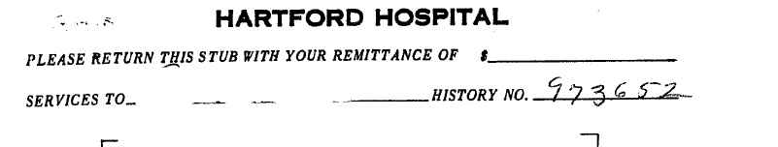
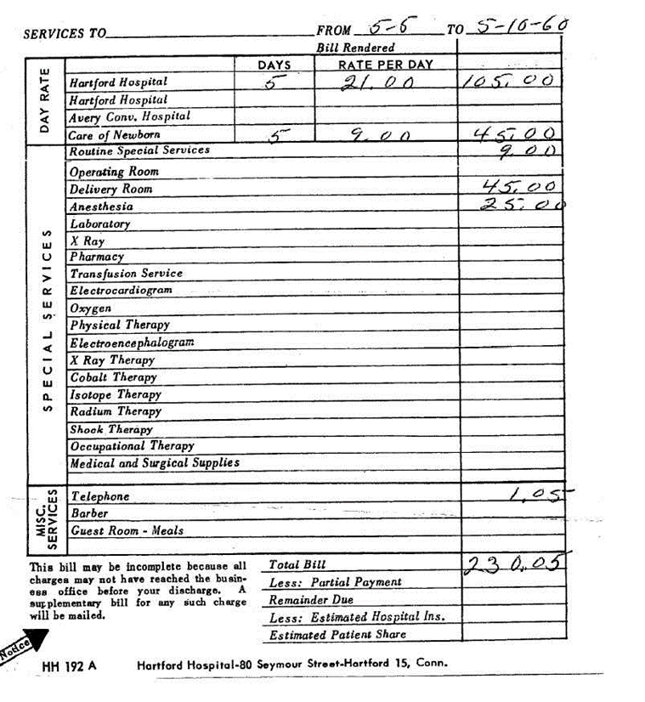
Approximately
$1,800
Today

Slide 9
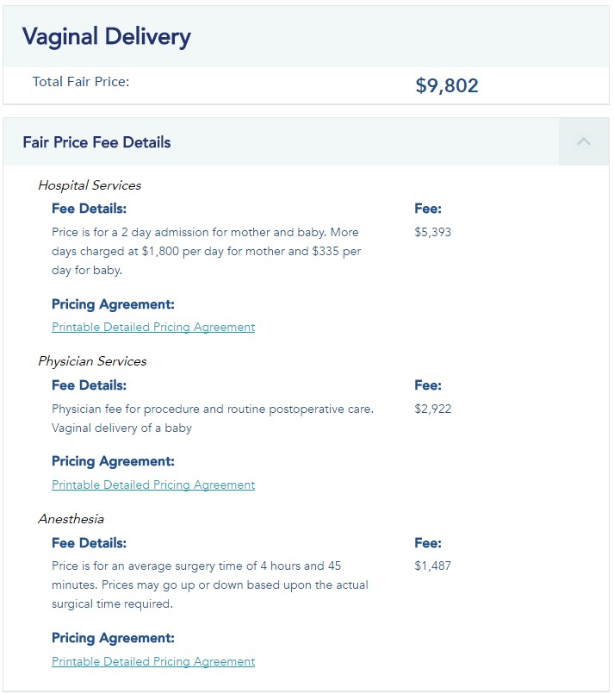

Slide 10
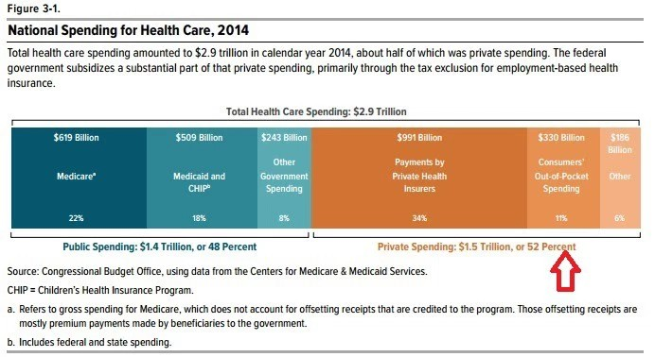
CBO JULY 2016

Slide 11
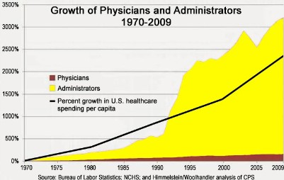
WHAT DO CONSUMER’S VALUE?
Data shows how
most of healthcare’s inflation has resulted from increased administrative
spending
*2300% increase in U.S. healthcare spending per capita
between 1970-2009 Source: Heath Care Costs: A Primer, The Henry J. Kaiser
Family Foundation

Slide 12
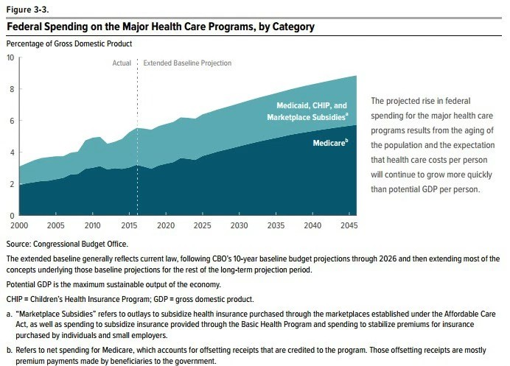

Slide 13
THE CHALLENGE
140M Consumers
Supply Side Push
ACO / PCMH / Pop Health
Value Based Reimbursement
Continued consolidation
Patients should value quality the way we define it.
175M Customers
Demand Side Pull
Employer shift to CDHP then DC
Increased economic exposure
Innovation in delivery and focus producing solutions that consumers want
Fracturing the health care consumption marketplace
New players (i.e., Walmart)

Slide 14
Revenue Cycle – The New World of Reimbursements
By 2018, 50% of Medicare Payments will be based on value-based payment models
By 2018, 95% of all Medicare Fee-for-Service payments will contain a quality component
  Utilizing Four Main Programs:
  Medicare Shared Savings Program
  Bundled Payments
  Primary Care Medical Homes
  Value-Based Purchasing Programs
  Five Common Features:
  Clinical Integration
  Team-Based Care
  Financial Risk
  Self-Governance
  Physician Leadership

Slide 15
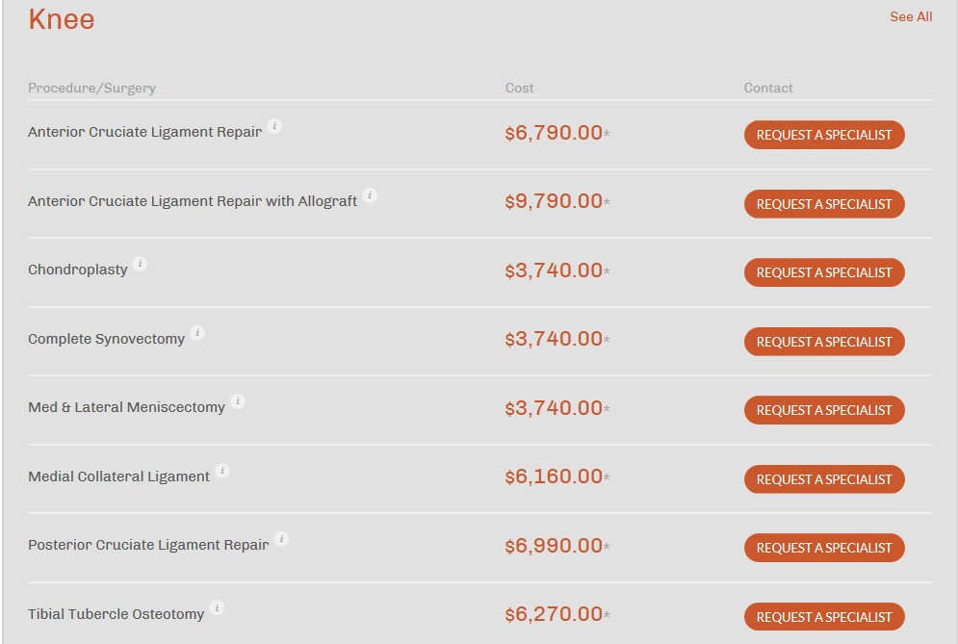

Slide 16
ACA Impact
TARGET AREA | 2013 | 2014 | 2015
Uninsured Rate | 41% | 17% | 13%
Under Insured (Deductible / Co-Pay over $2,500) | 22% | 29% | 43%
Medicaid Recipient | 10% | 13% | 16%
Healthcare Exchange | NA | 6% | 9%
Platinum | NA | 2% | 3%
Gold | NA | 17% | 13%
Silver | NA | 60% | 65%
Bronze | NA | 21% | 19%
Source: Kaiser Family Foundation

Slide 17
Future State of ACA
Target Area | 2016 | 2017 | 2018
Uninsured Rate | 10% | 9% | 4%
Under Insured (Deductible / Co-Pay over $2,500) | 43% | 49% | 52%
Medicaid Recipient | 16% | 18% | 20%
Healthcare Exchange | 11% | 13% | 15%
Platinum | 4% | 4% | 5%
Gold | 13% | 15% | 17%
Silver | 67% | 69% | 70%
Bronze | 16% | 12% | 8%
Source: Kaiser Family Foundation

Slide 18
Percentage of Covered Workers Enrolled in a Plan with a General Annual Deductible of $1,000 or More for Single Coverage, By Firm Size, 2006-2015
70%
All Small Firms (3-199 Workers)
All Large Firms (200 or More Workers) All Firms
63%
58%*
61%
60%
50%
49%
50%
46%
46%
40%
38%
41%
40%
35%*
34%
31%
39%*
30%
27%*
21%*
22%*
32%
18%*
26%
28%
20%
16%
10%
22%*
12%*
10%
17%
13%*
6%
8%
9%
0%
2006 2007 2008 2009 2010
* Estimate is statistically different from estimate for the previous year shown (p<.05).
2011
2012
2013
2014
2015
NOTE: These estimates include workers enrolled in HDHP/SO and other plan types. Average general annual health plan deductible s for PPOs,

Slide 19
How Much is too much?
Patients are unlikely to pay medical bills that are greater than 5.0% of household income, per The Advisory Board
Median household income in the United States is approximately $53,000 suggesting that when out-of-pocket expenses exceed $2,600 guarantor collections become extremely difficult

Slide 20
Provider Strategy: revenue optimization
ACHIEVE FOUR OBJECTIVES
THREE PRODUCT SUITES
THREE
CONCEPTS
Enhance
the Patient Experience
Better
Manage the
Insurance $
Payment Plans
Patient Statements & Collections
Guarantor A/R
Management
Increase
Yield
Tackle the
Problem
of Patient
Collections
Cost
Containment
Patient Revenue
Management
Accomplish Both by Focusing on
the Front End
Incremental
Net Revenue Enhancement
Patient
Access
Core Claim
Mgmt / Scrubber
Pre-Service
Clearance
Denial / Contract Management
Pre-Service
Clearance
Claim
Management
Authorizations
Coding / Clinical Advisory Services

Slide 21
Four Key Strategies
II. Increase Yield
Increase Insurance “Yield” (e.g., 88.0% - 99.0%)
Guarantor Recoveries (e.g., 38.0% to 70.0%)
Enhanced Denials and Contract Management Services
I. Enhance Patient Experience
Pre-Service Clearance
Retail Model
Comprehensive Transparency
IV. Incremental Net Revenue Enhancement
Eliminate Revenue “Leakage”
Health System Revenue Leakage 3.0% - 5.0% annually
Revenue Leakage vs. Revenue Preservation
III. Cost Containment
Capital Constraints
Increased Automation and Reduce “Cost-of-Rework”
Reduced Productivity (e.g., ICD’10)

Slide 22
Shifting Focus to Pre-Service Clearance
What it means…
Shifting the revenue cycle processes’ focus from “post-service” and “point-of-service” to “pre-service”
Performing all administrative functions associated with a scheduled appointment for a patient prior to the patient arriving for his/her service
Creating a “one stop shop” patient service call center in order to facilitate the patient experience
Leveraging technology, particularly mobile, to engage the patient prior to the visit

Slide 23
Shifting Focus to Pre-Service Clearance (continued)
Why it’s important…
Roughly 45% of denials are due to patient access issues
Only 40-60% of post-service patient responsibility is never collected
Expectation that this individual program/function would increase yield by approximately 3% to 4%
Tackles consumerism and patient experience head-on. Separates the patient clinical encounter from the financial clearance process in order for the visit to the provider to be purely clinically related
Allows for the conversion of the revenue cycle to a “clinically driven, retail model”
Provides for the horizontal integration of functionality across the revenue cycle, which will improve efficiencies, reduce the number of errors, and streamline the back-end process while enhancing the patient experience
Provides a mechanism to manage increased volume, due to the evolution of the market to a decentralized ambulatory or outpatient care model

Slide 24

Patient Services + Clinical Revenue Integrity + A/R Management
Pre-Service Clearance
Perform All Administrative Functions Prior to the Patient Encounter
Propensity-to-Pay
POS Standalone & Automated Batch Processing
Automated Authorizations & Referrals
Registration Quality Assurance (RQA)
Address Verification & Improvement
Online Patient Payments
SSN# Verification
Automated Workflow
Red Flag Alerts
Dual Eligibility Review
Pre-Registration and Registration
Medicaid Eligibility Screening
Automated Insurance Verification
(primary & secondary)
Presumptive Charity Care
Benefit Verification by Individual Plan
Coordination of Benefits
Network Status (patient and provider)
Patient Out-of-Pocket Estimates
Frequency Edits
Medical Necessity Checking
Search for Missing/Incorrect Insurance

Slide 25
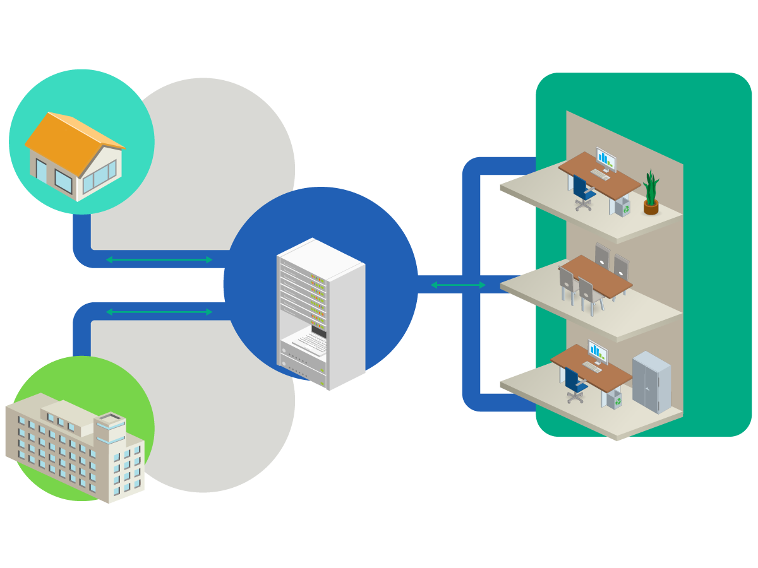
Solution overview – Patient Access automated workflow process
Physicians
Payors
1) Accurate Estimates based on Patient’s Plan and Historical payments
Eligibility & benefits
Care gaps
Authorizations/referrals
Attachments
Summaries
Claims
Remittances
Payments
2) Instant Response by Payers for Eligibility & Benefits
3) Patient Registration Staff equipped to collect “appropriate” POS Cash from Patient
Admission/
discharge
notifications
Lab/test results
Eligibility & benefits
Care gaps
Authorizations
Attachments
Claims
Remittances
Payments
Hospitals
4) “Notice of Admission” to the Payer

Slide 26

The intelligence Platform evolution of Technology and capabilities
That power the provider
Broad range of solutions built on a single, integrated platform
Optimized for risk adjustment as an initial priority focus
Enabled by a powerful suite of intelligence capabilities
Built on a foundation with world-class scale, security, reliability and flexibility
26

Slide 27
Competitive Differentiation
Investing in pre-service automation and services to simultaneously impact insurance and patient revenue yields
Leveraging OHP/payer data and networks in the pre-service program and the digital clipboard
Using a service model leveraging payer relationships to bridge the gap to full automation of authorizations, referrals and orders
Leveraging automation, patient engagement and payer data to empower a unique comprehensive guarantor A/R management offering

Slide 28
Appendix

Slide 29
Pre-Service Clearance Functionality
Standalone Point-of-Service Processing
Automated Batch Processing
  Propensity-To-Pay
    Address Verification and Improvement
    SSN Search and Verification
    Segmentation and Scoring
    Red Flag Alerts
  Insurance and Benefit Verification (e.g., primary and secondary)
  Benefit Verification at the Service Type Level
  Out-of-Network Benefit Verification
  Provider and Patient Network Status
  Cascading (e.g., incorrect, missing, uninsured, inactive primary/secondary insurance)
  Advanced Search Algorithms
  Coordination of Benefits (e.g., age, dialysis, MSP, Birthday Rule)
  Dual Eligibility Determination
  Membership Lists

Slide 30
Pre-Service Clearance Functionality (continued)
Automated Authorization Management
  An automated process to submit, obtain and manage the authorization process
  Complete Authorization Rules Engine by Payor
  Approximately 80% of the Process – Automated
  Automated Follow-Up
  Reconciliation of Authorizations
  Workflow Driven
  HIPAA Compliant
  Comprehensive Pre-Service Clearance Automated Batch Processing (e.g., including eligibility, benefits and demographic verification)
  Medical Necessity
  Frequency Edits / Limitations
  Embedded Management Analytics to Allow Reviews by Individual Physician, Practice, and Department by Service (e.g., Procedure) Performed by Payor.

Slide 31
Pre-Service Clearance Functionality (continued)
Calculation of “Out-of-Pocket” Estimates
  Provider based clinics (e.g., two bills, two out-of-pocket amounts and two deductibles)
  Calculate the value of two commercial insurances
  “Combined” out-of-pocket amount for recurring accounts
  Frequency edits or benefit limitations related to services provided or the corresponding utilization limits (e.g., archive search or payor data)
  Interpretation of modifiers and reduced reimbursement
  Government payors as secondary payors are not taken into account (e.g., prime paid more)
  Contract Management System
  Historical Charges
  Ability to email or fax the out-of-pocket estimate to the patient

Slide 32
Pre-Service Clearance Functionality (continued)
Comprehensive Guarantor A/R Management Services Functionality
  Provider based clinics (e.g., two bills, two out-of-pocket amounts and two deductibles)
  Propensity-to-Pay
  Address Verification and Improvement
  SSN # Verification
  Red Flag Alerts
  Early-Out Program (e.g., pre-collection)
  Patient Statements (e.g., paper and electronic)
  Bad Debt Collection Agency Program
  Second Placement Agency
  No Interest Patient Payment Plans
  Medical Eligibility (e.g., comprehensive sources)
  Alternate Funding Programs
  Patient Advocacy and Navigation
  Automated Presumptive Charity Care
  Liens/Accidents/Para Legal
  Collection Optimization Program (e.g., management of third party vendors)

