Slide 1
Training to Train, Adult Learning
CAHAM 49th Annual Conference and Exhibition

Slide 2
Agenda
Introduction
Module 1: Adult Learning
Module 2: Training Tools
Module 3: Training Approach
Module 4: Assessments & Reaction Forms

Slide 3

Module 1: Adult Learning
How do Adults Learn
Learning to Listen
How do we Remember
Topic Delivery

Slide 4
“How do YOU learn” Quiz…

Slide 5
QUESTION 1
If you saw the word “dog” written down, how would you react?
Imagine a dog in your mind
Say the word “dog” out loud to yourself
Imagine things related to a dog (barking, playing fetch)

Slide 6
QUESTION 2
You are playing a computer game and you want to figure out how to do something. What would you do?
Watch a video on the internet on how it is done
Ask someone to explain it to you
Figure it out by yourself by attempting to do it

Slide 7
QUESTION 3
Which of the following would you most likely do for fun?
Watch a movie
Listen to music
Some kind of physical activity

Slide 8
QUESTION 4
Which way do you prefer to study?
Looking at a diagram
Listening to an instructional video
Writing notes on a piece of paper and sticking them on the walls in your room

Slide 9
QUESTION 5
You just arrived to a city that is unfamiliar to you. How would you find a local supermarket?
Find and follow a map
Ask someone for directions
Keep walking around figuring it out for yourself, using landmarks to remember where you are

Slide 10
How did you do?
Count how many questions you answered “A”, “B”, and “C”
If you answered mostly “A”, you are a visual learner
If you answered mostly “B”, you are an auditory learner
If you answered mostly “C”, you are a hands-on learner

Slide 11
Adult Learning – Learning styles
Visual learners tend to:
  Sit in front of the class
  Look at the instructor’s body language and facial expressions
  Learn best from visual displays (diagrams, videos, manuals)
Auditory learners tend to:
  Learn best from lectures and discussion type training
  Listen to the tone of your voice to interpret importance/relevance
  Benefit from reading the information out loud
Hands-on learners tend to:
  Learn best from practice demonstrations
  Benefit from role playing
  Use activities and simulations

Slide 12
Adults learn best when:
  They understand the “why” it is important for them to learn or do
  They are allowed to learn in their own style
  They are allowed to experience what they are learning
  The time is right for them to learn
  They are encouraged to learn

Slide 13
Training your staff
Consider the different types of employees and the best training approach for each:
Let’s explore
Employee Type
Tenured System Savvy Star New Hire Non-Committed
Training Approach
Visual Auditory Hands-on

Slide 14
Tenured Employee
  1: Knowledgeable (Right or Wrong?)
  2: May find it difficult to adapt to change
  3: May not be technology savvy
  4: May go with the flow

Slide 15
Oppose Change
“that’s not how we do it”
“that’s not going to work”
“system is too complicated”
“this won’t last, I have been through dozens of these changes!”
“I don’t get this”

Slide 16
Why?
Fears
  Job loss
  Not technology savvy
  Not test takers
  Poor retention
  Added job duties
  Nervous about being observed
  Loss of past expertise and being the “go to person”

Slide 17
Best Training Approach – Visual and Auditory
Seeing, watching, listening, speaking
Explain the reason for the change
Use their knowledge and encourage discussions
Identify the ultimate goal and provide visual roadmap
Share the benefits of the new concept/idea/change
Recognize the hurdles before reaching the goal

Slide 18
Involvement is important for the “Tenured” employee
Involve employee in planning and implementation sessions
  System conversions
    Ask for their input
    Show the benefits of the new system
  Process changes
    Present the new process and ask for feedback
      Challenges
      Wins

Slide 19
System Savvy Employee
  1: Thinks they already know the application before you show it to them
  2: Is anxious to learn something new
  3: Is able to succeed quickly in the training

Slide 20
Caution
Some caution to consider with the “system savvy” employee:
  May get bored easily
  Have the “I already know this” attitude
  May seem uninterested
How do we engage them?

Slide 21
Best Training Approach - Hands-On
Involve, Involve, Involve
Practice and hands-on exercises
Challenge them to “break” the application and/or system
Listen for their ideas, questions, and suggestions
Identify if they can assist with training

Slide 22
Why?
System Savvy employees can be your biggest rock star!
  They can assist with the development phase
  They can help create a positive attitude on the new application with their co-workers
  They can assist with training

Slide 23
Star Employee
  1: Knowledgeable
  2: Eager to embrace change
  3: Quick learner
  4: Keeps positive morale in the group

Slide 24
Considerations
Star employee may:
  Not be ready for change
  Not be as knowledgeable as you think
  Not be technologically savvy
  Ability to influence others

Slide 25
Best Training Approach – Visual and Hands-On
Need to see and do
Make it relatable
Use their strengths
Show examples to keep them engaged
Involve them in the planning and implementing sessions
Let them be your “cheerleaders”

Slide 26
New Hire Employee
  1: No knowledge
  2: Limited/Some knowledge
  3: Easily motivated
  4: Wants to do a good job

Slide 27
Best Training Approach – Visual, Hands-On, and Auditory
Need to see, listen, and do
Explain in detail, make no assumption
Make it relatable
Use their past knowledge to introduce new concept
Use visual aids
Provide examples and allow for hands-on exercises
Role-Play

Slide 28
Non-Committed Employee
  1: “just a job” employee
  2: Part-time job
  3: PRN
  4: Seasonal job
  5: Trying something new

Slide 29
Comments
“this is just my part-time job”
“I just need to finish school”
“I only need to work XX hours to pay rent/school/debt”
“too much for me”
“I can do this!”

Slide 30
Best Training Approach – Visual and Hands-On
Need to see and do
Provide visual aides to explain the importance and impact of the training
Set clear goals of what the training is expected to achieve
Have practice and observation exercises
Assess knowledge and retention

Slide 31
Learning to Listen
We listen to obtain information
We listen to understand
We listen for enjoyment
We listen to learn

Slide 32
We Remember
10% of what we read
20% of what we hear
30% of what we see
50% of what we see and hear
70% of what we discuss with others
80 % of what we personally experience
95% of what we teach others

Slide 33
Topic Delivery
Relatable
  Training topic must be of importance
Meaningful
  Training must define impact on job
Understandable
  Training must be delivered in a clear and concise manner
Enjoyable
  Training should be fun!

Slide 34
When everything fails
Identify root cause:
  Is it a particular concept?
  Is it the delivery? (visual, audio, hands-on)
  Is it the implementation?
  Is it retention?
  Is it a test taking issue?
  Is it not the right fit?

Slide 35
Summary
There are 3 types of learning styles: visual, auditory, hands-on
Identify which learning style is best suited for your employee
Adults “listen” to learn
Adults “remember” most from repetition
When training, remember that the topic must be relatable, meaningful, understandable, and enjoyable!

Slide 36

Module 2: Training Tools
PowerPoint Presentation(s)
Training Manuals
Handouts
Job Aides
E-Learning

Slide 37
PowerPoint Presentations
Rules to consider:
Do’s | Don’ts
Use key phrases | Avoid paragraphs
Use relatable images | Avoid cartoons
Use no more than 2 fonts | Avoid multiple fonts and colors
Select appropriate slide design | Avoid clutter
Show emphasis on specific fact(s) | Avoid detailed reports

Slide 38
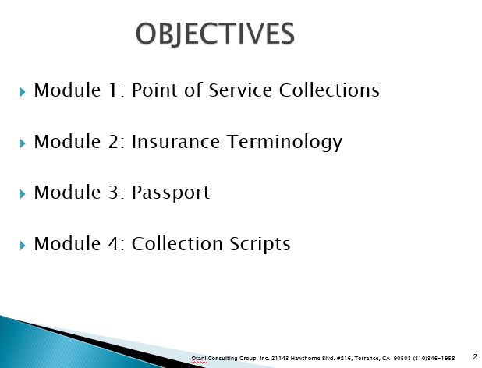
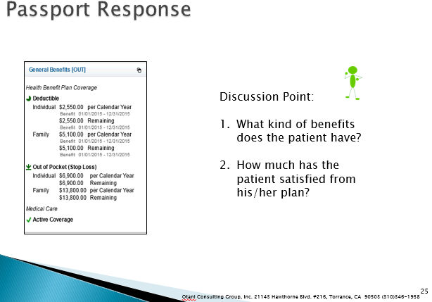
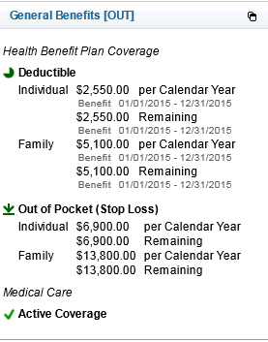
Sample OCGI POS PowerPoint Training

Slide 39
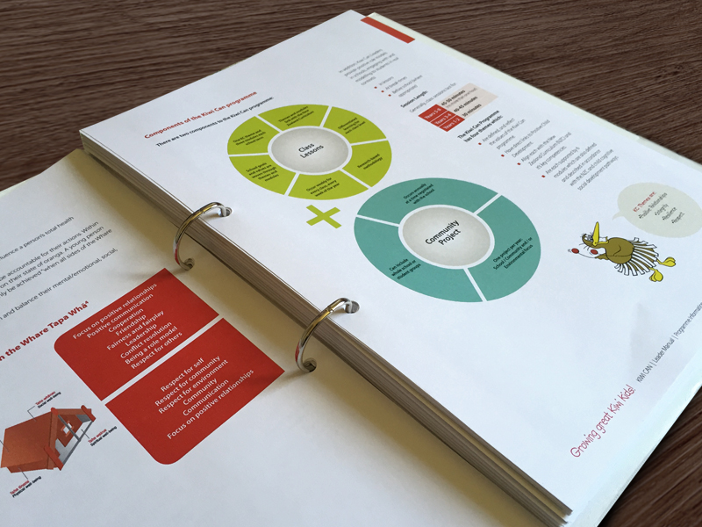
Training Manuals
Reference guide
Detailed information by topic
Easily accessible
  Online
  Physical copy
Enforces consistency

Slide 40

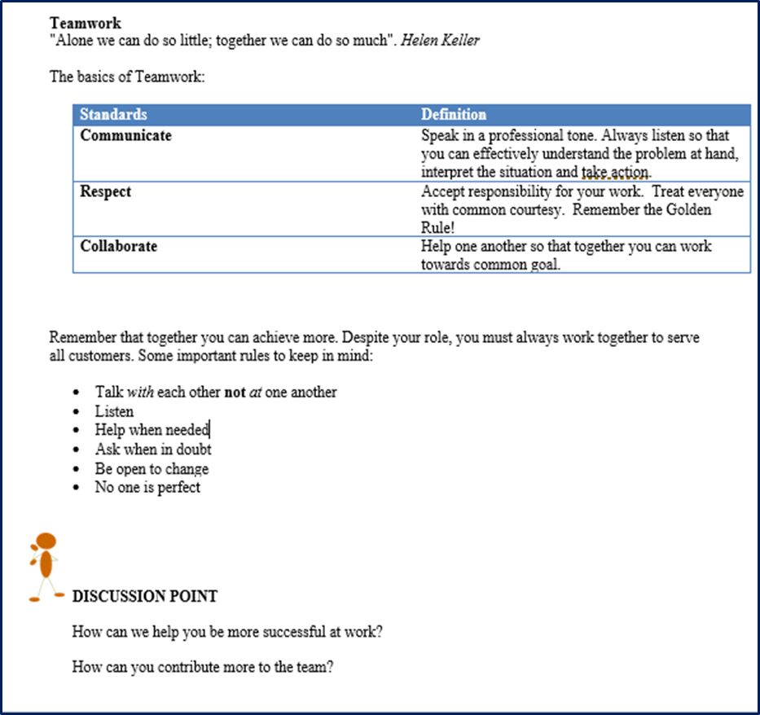
Sample OCGI Back to Basics Training Manual

Slide 41

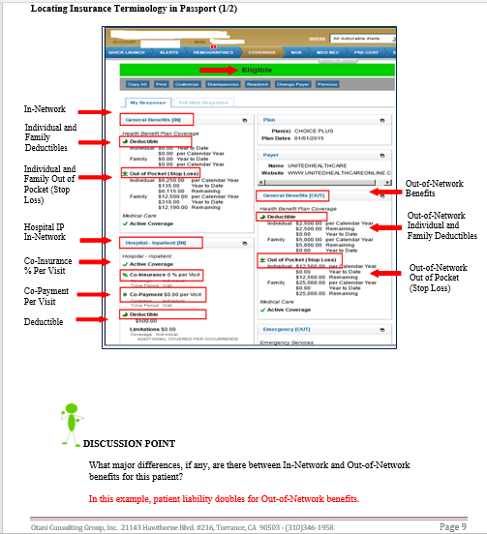
Sample OCGI POS Training Manual

Slide 42

Handouts
Offers detailed information on specific task, project, process, etc.
Easy to read and review
Summary of key points
Used in combination with PowerPoint presentations

Slide 43
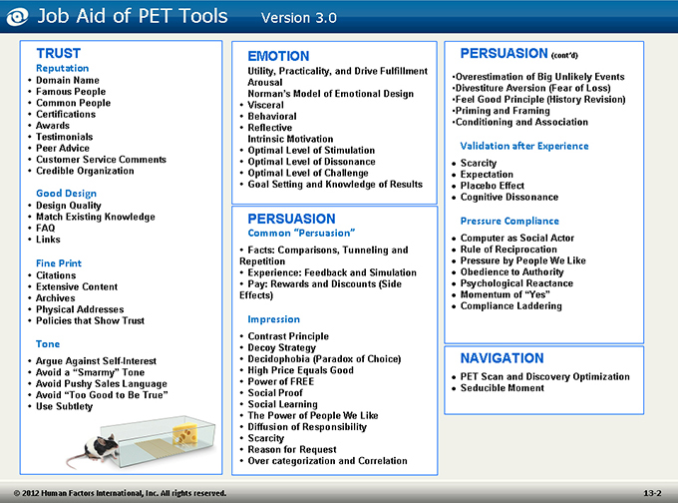
Job-Aids
Reference tool
Provide updated information
Helps employee retain information
Reinforces consistency

Slide 44
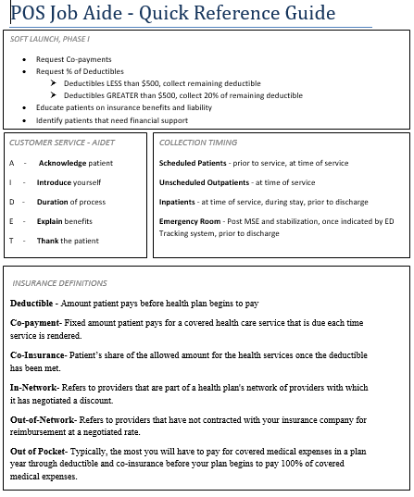
Sample OCGI POS Job Aid

Slide 45

E-Learning
Accessibility
Learning at your own pace
Interactive format
Cost effective

Slide 46
Summary
PowerPoint presentations should be used as talking points
Training manuals offer consistency
Hand-outs and Job Aides offer quick training tips
E-Learning may allow for a more convenient and cost effective training approach

Slide 47

Module 3: Training Approach
Identify training need
Select venue
Choose resource
Setting up the classroom

Slide 48
Identify the training need
Individual learning
Group learning
Department learning
Management learning

Slide 49
Examples
Individual learning | Group learning | Department learning | Management learning
Specific employee Example | Specific area Example | Learning applies to all Example | Leadership training Example
Individual employee with continued registration errors Supporting New hire | Pre-registration incoming queue times Insurance verification days out | Patient check-in procedures POS collection goal | Hiring/Interviewing techniques New/Updated Policies and Procedures review

Slide 50
Select venue
One-on-one
Monthly meeting
On the job training
Set curriculum
E-learning
Web-based learning

Slide 51
Examples
One-on-one | Monthly meeting | On the job training | Set curriculum | E-Learning | Web-based learning
Training geared towards one person where immediate feedback is important. Example: | Information that can be trained quickly Example: | Single item system/process change Example: | Training applies to all or specific group(s) Instructor-led Example: | Training applies to all or specific group(s) Pre-recorded classes Example: | Training applies to all or specific group(s) Real time instructor-led training Example:
New hires Employee concern QA reviews | MSP question New payor New form | New online verification tool New payment processing screen New patient check-in process | New Hire Training Medicare training Point of Service Training | Consent forms HIPAA updates Refresher courses | MSPQ questions & answers Calculating POS Refresher courses

Slide 52
Choose Resource
Instructor-led
  Dedicated trainer
  Supervisor
  Manager
  QA Specialist
E-Learning
  Pre-set online courses/classes
  Recorded webinars
Buddy-system
  Team lead
  Star employee

Slide 53
Examples
Instructor-led | E-Learning | Buddy-system
Set class curriculum Example: | Web class catalog Example: | Team lead/Star employee with new hire Example:
New Hire Training Back to Basics Training Medicare Training | Regulations Customer Service Payor Identification | System demonstration Process demonstration Show/Do

Slide 54
Setting up the classroom
2 to 4 weeks prior to training order or request:
  Training roster with participant information
  Training manuals for printing, shipment, and delivery
  Training equipment such as computers, laptop and overhead projector
  Conference room or classroom for training
  Refreshments, if offered

Slide 55
Setting up the classroom
1 week prior to training:
  Confirm final training roster with participant information
  Confirm training manuals have been delivered
  PowerPoint presentation is complete
  Easel boards, markers, paper and all other training materials are confirmed
  Training equipment is secured and ready
  Refreshments are scheduled and ordered (if applicable)
  Obtain facility contact in case of emergency

Slide 56
Setting up the classroom
On the day of training:
  Arrive at least 30 to 45 minutes before training begins
  Power up all equipment
  Place manuals, pens, paper and all other training material on desks/tables
  Familiarize yourself with the closest bathrooms, cafeteria, and break rooms
  Provide sign-in sheet

Slide 57
How to handle the unexpected
Always have a paper copy of your training/presentation ready in case of technical malfunctions
Always order at least 5 extra manuals/handouts/training material
Ensure the classroom/conference room can accommodate at least 5 to 10 extra participants
Stay calm

Slide 58
How to handle difficult participant(s)
Do’s
Keep them engaged
Acknowledge their experience and call on them for specific examples
Thank them for their input
Don’ts
Become argumentative
Yell or raise your voice
Allow your anger to show

Slide 59
Summary
Identifying the training need will determine the best training approach:
  Individual vs. group training
  One-one vs. classroom
  Trainer vs. E-Learning
Create a training check-off list
Learn how to handle training obstacles

Slide 60

Module 4: Assessments and Reaction Forms
Creating the assessments
How to assess
Importance
Reaction Forms

Slide 61
Creating the Assessment
Key things to remember when creating an assessment:
  Relevant
  Easy to understand
  Multiple answer selection
  Appropriate number of questions

Slide 62
Topic Relevance
Only “test” on the information taught
Create questions that test facts, concepts, and the application of such
Avoid confusing and “tricky” questions

Slide 63
Language
Assessments must be easy to understand
Use the same language that was used during training
Ensure that the questions are worded correctly
Avoid confusing questions with multiple thoughts

Slide 64
How to assess: Basic assessment rules
Explain assessment instructions to all participants
Provide a quiet space for all test takers
Do not engage in long discussions on questions during assessment
Provide privacy

Slide 65
Grading the assessment
Grade the assessment within 24 to 48 hours of course completion
Identify trends on question(s) missed
Provide assessment results to the department manager and/or individual trainee
Provide class feedback to department manager

Slide 66
Assessments – why is it important?
Retention
Understanding
Identify further training needs
Consider other training concepts/ideas

Slide 67
Course Survey
It shows how well the training program met the participant’s needs and expectations
Provides feedback on new knowledge or skills learned for the participant
Allows participants to provide feedback on the training
Provides the trainer with improvement opportunities

Slide 68
Summary
Assess only on the information taught
Do not use trick questions
Use assessments to identify training opportunities
Remember that not everyone is a test-taker!
Use “Reaction Forms” to help you improve as a trainer

Slide 69
Group Assessment

Slide 70
List the 3 types of learning approaches discussed in Module 2
Visual
Auditory
Hands-on

Slide 71
True/False - We remember 95% of what we teach others
True

Slide 72
What are some possible root causes that may explain why a training may not be successful?
Delivery
Implementation
Retention
All of the above

Slide 73
When creating a PowerPoint presentation, you should:
Use key phrases and avoid paragraphs
Use multiple fonts and avoid colors
Use detailed reports and avoid clutter
Use paragraphs and avoid cartoons

Slide 74
When creating an assessment you should consider:
Course relevance
Number of questions
Individual vs. group
All of the above

Slide 75
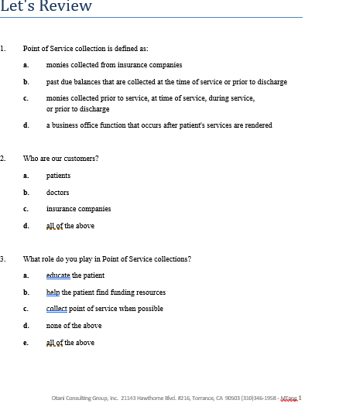
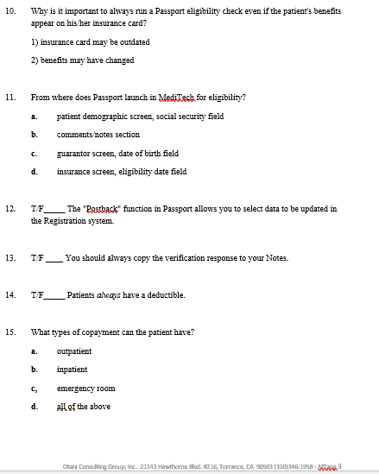
Sample OCG Assessment

Slide 76
Remember…
Not all learners are test-takers
Test anxiety is real
Do not base student knowledge and retention solely on a test. Instead:
  Engage students throughout training
  Ask questions to test knowledge
  Promote discussions to confirm understanding

Slide 77
Class Summary
Adults learn best when they are allowed to learn best in their own style
Select the training tool that best fit the training need
Identify the venue in which the training will be delivered
Assess only what was taught
Provide timely feedback to participants and managers on their assessment results

Slide 78

Questions

Slide 79
Thank You

Slide 80
Resources
http://www.businessmanagementdaily.com/5880/7-rules-for-powerpoint-simplicity
http://totalcommunicator.com/vol4_1/handouts.html
http://www.academia.edu/1156858/Group_work_and_individual_assessment

