Slide 1

SKITTLE SKUTTLE
INTRODUCE YOURSELF, YOUR ORGANIZATION, YOUR ROLE
RED – What do you want to do in 5 YEARS?
GREEN – What is your biggest challenge leading a TEAM?
PURPLE – What do you like about your ROLE?
YELLOW – What is your DREAM JOB?
ORANGE – WILD CARD
(Tell us anything about yourself)

Slide 2

Understanding Team
Using MBTI
=
Notes:
Team chemistry. An essential ingredient in success. Whether success is a record or an experience or both. It’s all about creating conditions where a diverse group – or a crazy cast of characters – can succeed.
Chemistry is when 1+1 = 3. It is a synergy that comes from releasing all the talent, energy, and pleasure you can from a diverse and motivated group.

Slide 3

MBTI Quick Facts
Build better relationships and gain better results
Enhance self-understanding
Understand and appreciate diversity
(rather than just tolerate)
Increase range and scope of communication
MBTI provides an individual assessment used to determine innate preferences and assign a 4-letter personality type (i.e. INTJ, ESFP, ENTP, ISFJ, etc.)
Where do I look to learn more? www.myersbriggs.org
Many concepts, diagrams, and pictures were taken from the MBTI Presenting Types in Organizations, developed by David Freeman, Linda Kirby, and Nancy Barger
Notes:
Try to relate everything back to team chemistry, long-term personal benefit for team
Beauty about this is that it ultimately must be self-verified. You will determine what you are.

Slide 4
What do you mean by preference?
Write your name using your dominant hand:
_______________________________
Write your name using your NON-dominant hand:
________________________________
We can all use both hands for writing, but one is natural, comfortable, automatic
Notes:
Where does this preference come from? How does the environment shape it? What is the benefit of executing this skill “in type” or “with preference”?

Slide 5




MBTI Preferences – 4 Dichotomies
      Where you direct your energy
        Extraversion vs Introversion
      How you gather information
        Sensing vs iNtuition
      How you make decisions
        Thinking vs Feeling
      How you deal with the outside world
        Judging vs Perceiving
Notes:
There are two ways to answer each question – 1 is the HOV lane, 1 is the traffic jam

Slide 6

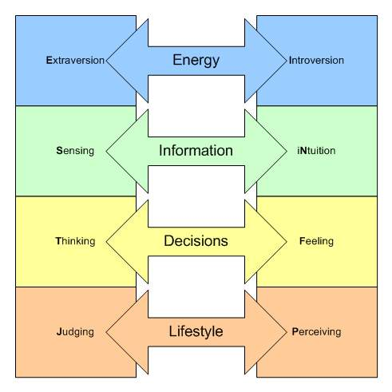
More about preferences…
  Preferences are not measured on a spectrum
  – either you prefer this or you prefer that
Notes:
During the next few minutes we will go over each set of preferences. Please try to figure out which preference best describes you. Also think of examples on your team where a conflict or example of preference occurs. We will also talk about the implications for coaching different preferences.

Slide 7
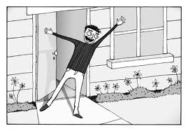
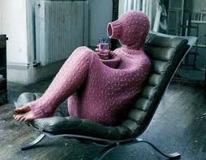

What do E’s and I’s look like and do?
Seek and value input from many Seek input from chosen few
Respond to external expectations Focus on internal objectives
Seek assistance actively Rely on inner resources
Share things openly Keep things to themselves
Seek group interaction Seek small group interaction
Focus on breadth Focus on depth
Start with actions Start with ideas
Notes:
Examples:
Locker Room outbursts
How team meetings are structured – is there opportunity to prepare ahead of time? Is there group work?
Talking on the court/field – is it worth it given the energy expenditure?
Needing to do the action before understanding the concept
Recruiting match-ups

Slide 8



What do S’s and N’s look like and do?
Enjoy practical conversations Enjoy clever conversations
Use detailed description Use metaphorical descriptions
Move sequentially Skip around
Prize specifics and realism Prize hunches and insights
Rely on and trust experience Rely on and trust inspiration
Confidence grows from repetition Confidence from innovation
Use accepted ways of leading Try new ways of leading
Notice specifics/facts Notice subtleties/patterns

Slide 9


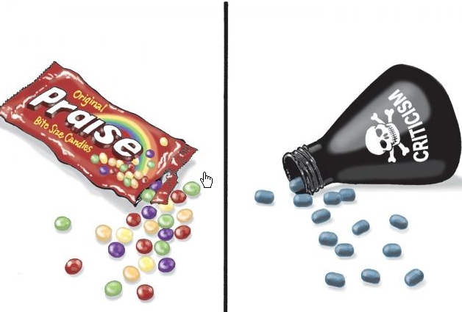
What do T’s and F’s look like and do?
Start with a critique Start with praise
Examine conflict to find truth Avoid conflict to maintain harmony
Business-like Sociable
Want feedback to improve Want support for efforts
Apply policy consistently Make exceptions to policy
Seek efficiency Seek dedication
Results-based Consensus-based
Objective analysis Subjective analysis

Slide 10
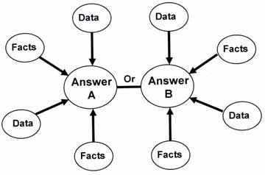

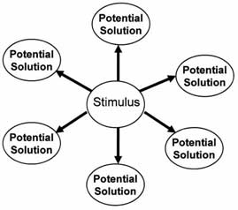
What do J’s and P’s look like and do?
Use decisive words/fixed positions Use hedging words/tentative possibilities
Dislike being sidetracked Being sidetracked is interesting
Put work before play Combine work and play
Value steadiness/thoroughness Value flexibility and adaptability
Act on set priorities Respond to opportunities as they arise
Prefer to have control Prefer to have freedom
Make quick decisions Avoid making decisions

Slide 11
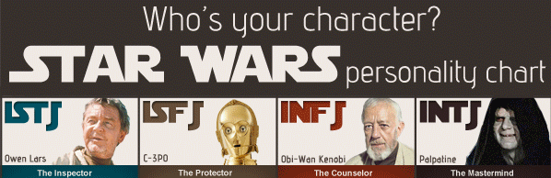



What is Your Type?
When you are in a situation that requires you to act out of preference for a long time, STRESS WILL RESULT

Slide 12
MBTI exercises to try with your team
The Marshmallow Challenge
http://www.youtube.com/watch?v=H0_yKBitO8M
http://www.ted.com/talks/tom_wujec_build_a_tower?language=en

Slide 13
GOAL SETTING
Why is it important?
Aligns Employees with the Vision, Mission, Standards
of the Department and Facility
How do you make a goal?
S.M.A.R.T.
Specific, Measureable, Attainable, Timed
How do you make it happen?
Leaders, Trainers, Veteran Employees, Team Leads, Supervisors to positive “coaching” techniques
When do you start setting goals?
Anytime you see an opportunity, team meetings, new hires, when your metrics indicate a decline, always in private.

Slide 14

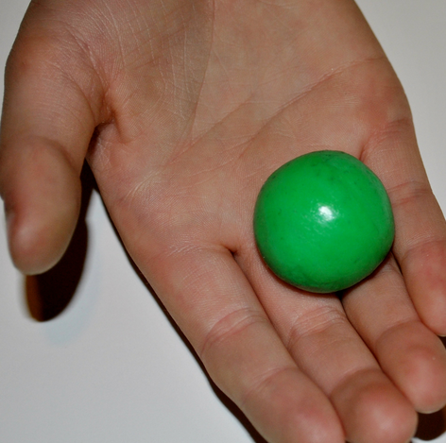
COACHING
Find the ball

Slide 15



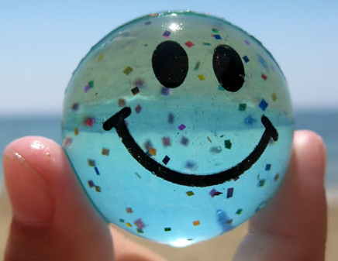
COACHING RESULTS
NO Feedback
Negative Feedback
Positive Feedback
IS POWERFUL! When coaching your message should be clear, positive and encouraging.

Slide 16
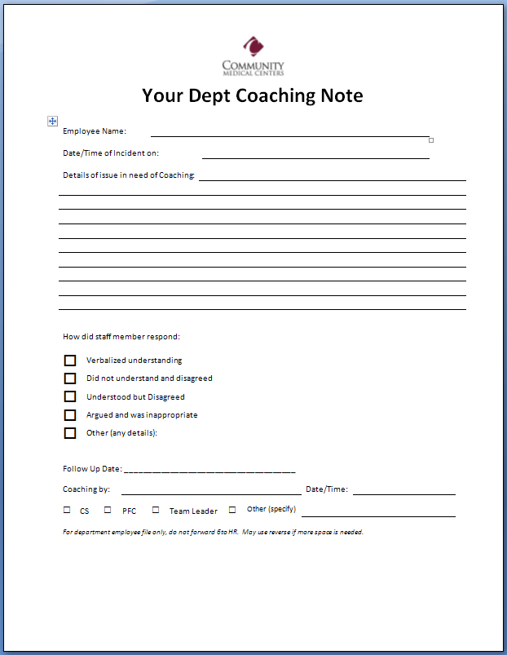
COACHING NOTE (optional)

Slide 17
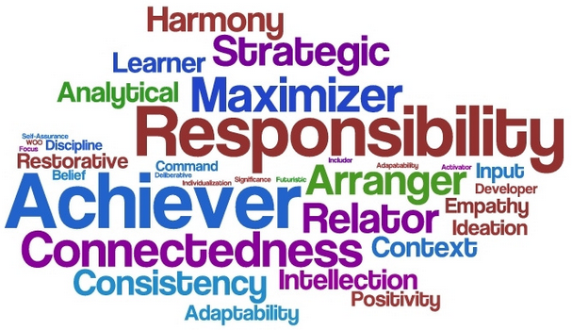

IDEAS FOR UNDERSTANDING and RECOGNITION
Strengthsfinder 2.0 by Tom Rath www.gallupstrengthscenter.com

Slide 18


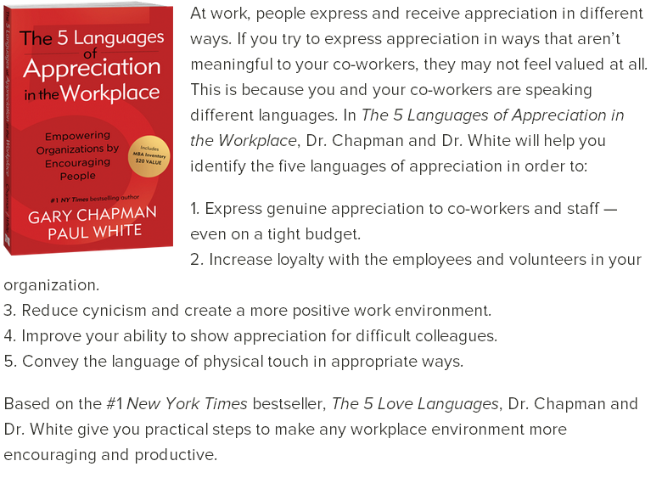
IDEAS FOR UNDERSTANDING and RECOGNITION
The 5 Love Languages and The 5 Languages of Appreciation in the Workplace www.5lovelangues.com

Slide 19
THANK YOU!
Enjoy the rest of your time at CAHAM
Community Regional Medical Center
Regina Olvera, Outpatient Lab Supervisor
rolvera@communitymedical.org
Direct: 559-459-2714 Cell: 559-776-9337
Lynnette Bassett, Outpatient Lab Customer Service
lbassett@communitymedical.org
Office: 559-459-2771

