Slide 1
49th Annual Educational Conference & Exhibition
September 27 – 30, 2017

Slide 2
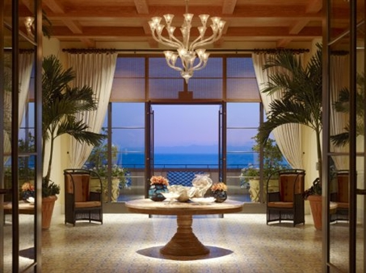
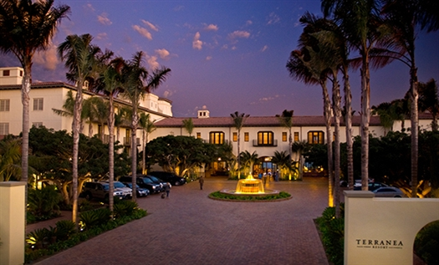
Join Us At Terranea Resort

Slide 3
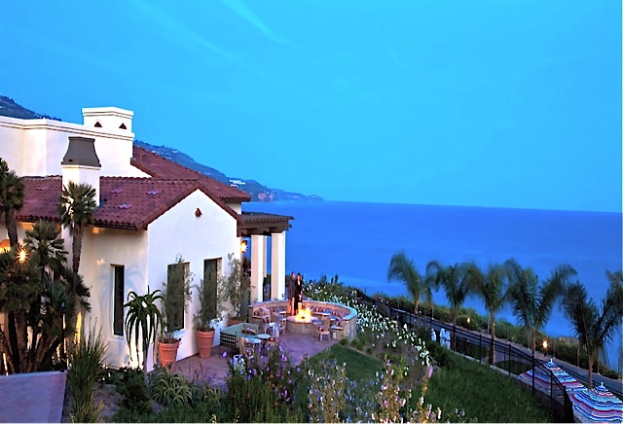
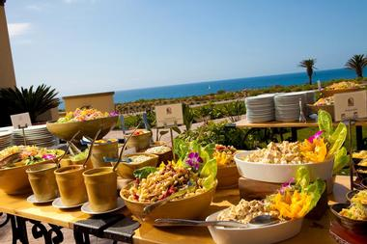
$235 CAHAM Conference Rate
Resort Fee Waived / Special Valet Parking Rate

Slide 4
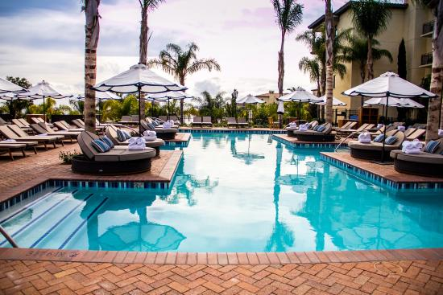
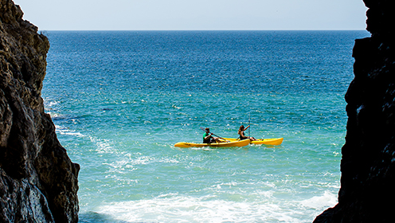
CAHAM Rate Available
3 Days Pre & Post Conference

Slide 5
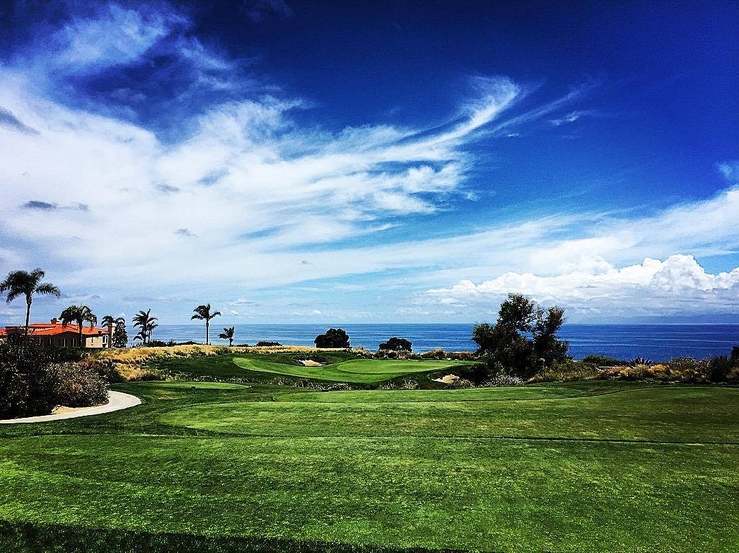
Discounted Golf Rates – Choose From 3 Courses
Links at Terranea, Trump National, and Los Verdes CC

Slide 6
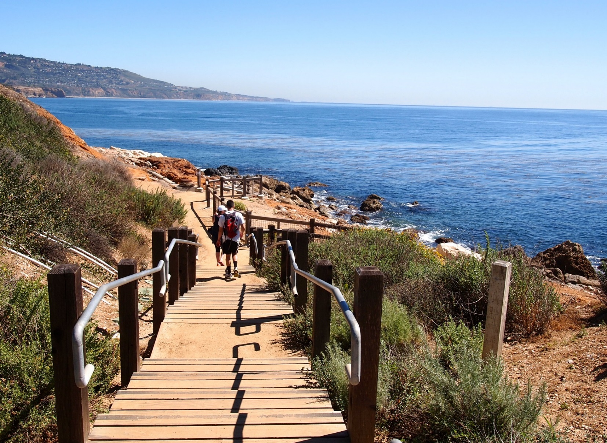
Beautiful Hiking Trails

Slide 7
Reconnect with Old Friends, Make New Friends, Beautiful Grounds, Great Memories

Slide 8
100 Terranea Way
Rancho Palos Verdes, California 90275
(866) 547-3066
(310) 265-2270
Reservation Can Be Made Via Phone or Online
www.terranea.com

