Slide 1
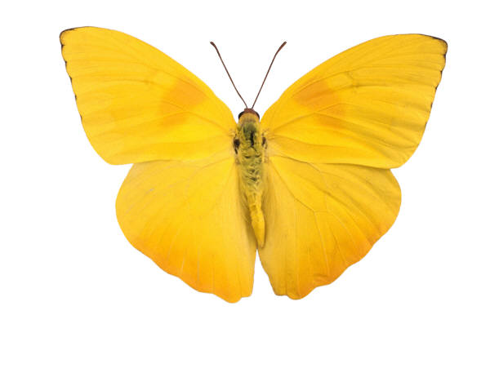
Lean
Citrus Valley Health Partners
Cynthia Routt-Vargas
Certified Lean Six Sigma
Green Belt
Notes:
Introduction self and Lean

Slide 2

Lean Certification
Process Excellence at CVHP
Process Excellence
Lean
Green Belt
Black Belt
Lean Certification
Training
Projects
Projects
Lean Certification Projects
Six Sigma
Other Lean Projects
Mentoring
Sustainability
Advanced Analytics and statistics
Notes:
Process Excellence is important to CVHP because:
Supports Lean Six Sigma activities
Utilizes strategies, tools, methods including Lean, Six Sigma, and Change Management.
Monitors and assists with LSS projects.
Supports sustainability and spread.
Lean Six Sigma (LSS) training and certification programs
Trains staff to be able to use LSS tools and strategies.
It works to create a culture of safety and innovation
Used to improve processes and clinical outcomes
Improves financial stewardship and sustainability
Essential to transforming CVHP into a High Reliable Organization (HRO)

Slide 3

Notes:
Tim U Woods: DOWNTIME video courtesy of Youtube and Univeristy Health Network out of Canada

Slide 4
Lean
Introduction to Lean
Lean Eliminates Waste using
Tools, Daily Continuous Improvement,
Respect for People
Notes:
Lean
Lean is a well-defined set of tools that increase customer value by eliminating waste (muda: Japanese word for “waste” that we will discuss a little later on) and creating flow throughout the value stream. Lean improvements are generally inexpensive to implement, focus on improving the process, not the people and promote simple, error proof systems.

Slide 5
Lean
Introduction to Lean
Lean Healthcare
  Can change the way hospitals are organized and managed.
  Allows hospitals to improve the quality of care for patients by reducing errors and waiting times.
  Eliminates staff roadblocks and allows us to focus on providing care.
  Fixes the process where the work is actually done, by the people who do the work.
  The process is broken, not the people.
  Requires continued learning.
Notes:
Origins of Lean
History of Lean. When we talk about lean, the first name that strikes our mind is Toyota. However, it is worth noting that the history of lean started way back in 1450s in Venice, and thereafter the first person who integrated the concept of lean in the manufacturing system was Henry Ford.
Henry Ford – Dearborn Michigan hospital in 1922.
Toyota Motor Company 1945.
MIT’s International Motor Vehicle Program coins the term “lean”.
Henry Ford in his efforts to apply production methods to a hospital in 1922 wrote:
“It is not at all certain whether hospitals as they are now managed exist for patients or for doctors…it has been an aim of our hospital to cut away from all of these practices and to put the interest of the patient first…In the ordinary hospital the nurses must make useless steps. More of their time is spent in walking than in caring for the patient. This hospital is designed to save steps. Each floor is complete in itself, and just as in the factories we have tried to eliminate the necessity for waste motion, so we have tried to eliminate waste motion in the hospital.”
A Word on “Broken Processes”
There is a natural tendency to blame the people involved when something goes wrong. How often do we hear managers and leaders say they wish their people would feel more ownership for their processes? But how many people want to own a broken process, where they are blamed for poor results? We are surely not respecting the individual if we are asking them to operate broken processes. The role of mangers and leaders is to provide the resources and support that help people to understand and improve their own processes. Focus on process truly challenges us to think and work in a different way. In order for CVHP to be successful in achieving zero harm, we have to create great processes that set our colleagues up to succeed.

Slide 6
Lean
Define Value - The 8 Wastes
Discovering your project
First Step:
Focus on the Opportunities
by Identifying Waste
Notes:
We’ll begin choosing our project with our first step which is to identify waste.

Slide 7
Lean
Define Value - The 8 Wastes
Categorizing Waste
D | Defects
O | Overproduction
W | Waiting
N | Non-Utilized Talent
T | Transportation
I | Inventory
M | Motion
E | Extra-Processing
Notes:
Note: Here are our 8 wastes. Let’s dig a little deeper into some examples of each of these wastes

Slide 8
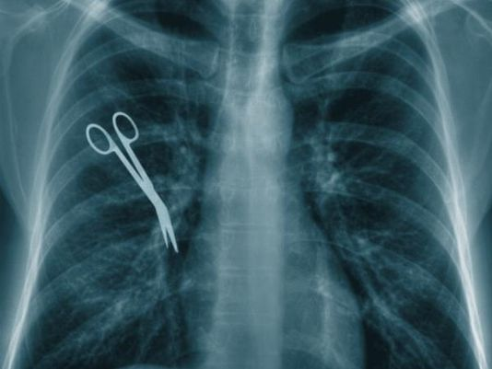
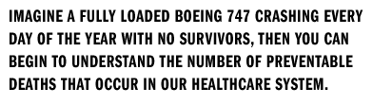
Lean
Define Value - The 8 Wastes
Defects - Errors
  Dispensing or administering to the wrong patient.
  Choosing the wrong procedure or site.
  Choosing the wrong patient medical record and registration.
Notes:
List the DEFECTS that are discussed: Ask for defects
Examples:
Emailed to the wrong recipient
Incorrect patient account #’s
Incomplete forms
Illegible
HIPPA violations
Misdiagnosis
Missing items
Re-sticks/re-draws
Treatment failures
Wrong patient, drug, lab test etc.
Defect Definition - A defect is defined as any part of a product or service that does not meet customer specifications or requirements, or causes customer dissatisfaction, or does not fulfill the functional or physical requirements.

Slide 9
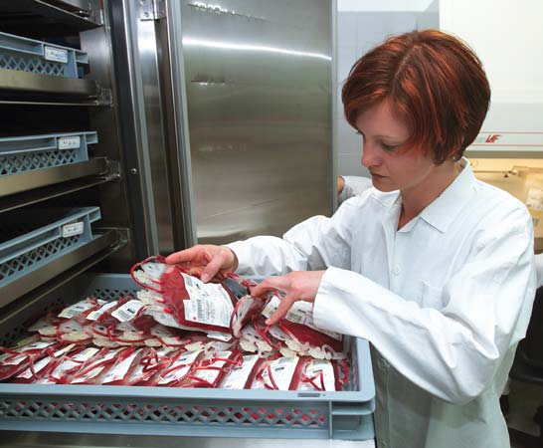
Lean
Define Value - The 8 Wastes
Overproduction – Too much
  Excessive amount of tests being ordered for the convenience or liability of the organization.
  Food that goes uneaten or spoils.
Notes:
List the OVERPRODUCTION waste that is discussed: Ask for other examples
Examples:
Buying items before they are needed
Just-in-case extra tube of blood
Making more than is needed
Prescription dispensed but not used
“Reply All” to emails
Too much information
Unnecessary steps in a process
Work flow bottlenecking
Overproduction Definition - Overproduction is making products in too great a quantity or before it is actually needed leading to excessive inventory. Overproduction is the worst of the seven wastes as it obscures all of the other problems within your processes.

Slide 10
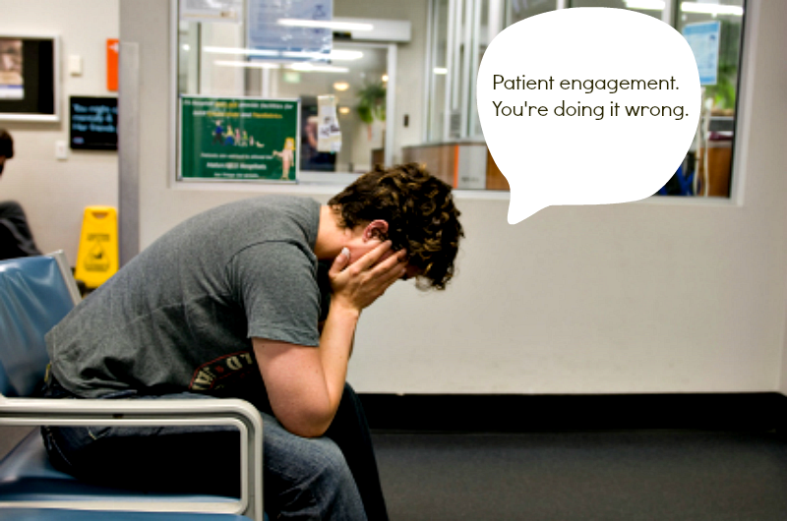
Lean
Define Value - The 8 Wastes
Waiting - Delays
  Physicians wait for patient lab results.
  Patients wait for …everything!
10
Notes:
List the DELAYS that are discussed: Ask for other examples
Examples:
Approvals
Decisions
Diagnosis
Email/Phone responses
Idle employee time
Ineffective meetings
Medications/Treatments
Signatures
Waiting rooms
Employees w/multiple responsibilities (we wait on them)
Waiting Definition - Waiting for the previous step in the process to complete.

Slide 11

Lean
Define Value - The 8 Wastes
Non-Utilized Talent – Excluding
  Not properly utilizing experience, skills, & ideas.
  We lose ideas, improvement opportunities & learning opportunities.
Notes:
List the NON-UTILIZED TALENT examples that are discussed: Ask how their unit engages staff and if they encourage sharing of ideas
Examples:
Employees not involved in problem solving
Insufficient training
Lack of cross-training
Limited employee authority
Non-Standardized evaluation checklists
Non-Utilized Talent Definition – Employees that are not effectively engaged in the process
Muri (Overdoing)
Muri is the unnecessary or unreasonable overburdening of people, equipment, or systems by the demands that exceed capacity. This applies to how work and tasks are assigned and can show up in excessive meetings or overtime hours worked.

Slide 12
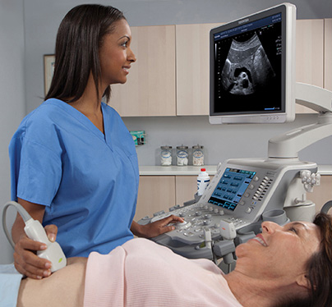
Lean
Define Value - The 8 Wastes
Transportation - Equipment movement
  Equipment that is moved from room to room.
  Supply and paperwork movement.
Notes:
List the TRANSPORTATION wastes that are discussed: Do not confuse with people movement. Ask where their supplies are in relation to the staff.
Examples:
Equipment movement
Hand carrying paperwork
Moving stock around to inventory
Moving products to different work stations (specimens around the lab)
Opening and closing multiple applications on 1 computer screen
Patient movement
Transportation Definition – Transporting items or information that is not required to perform the process from one location to another.

Slide 13
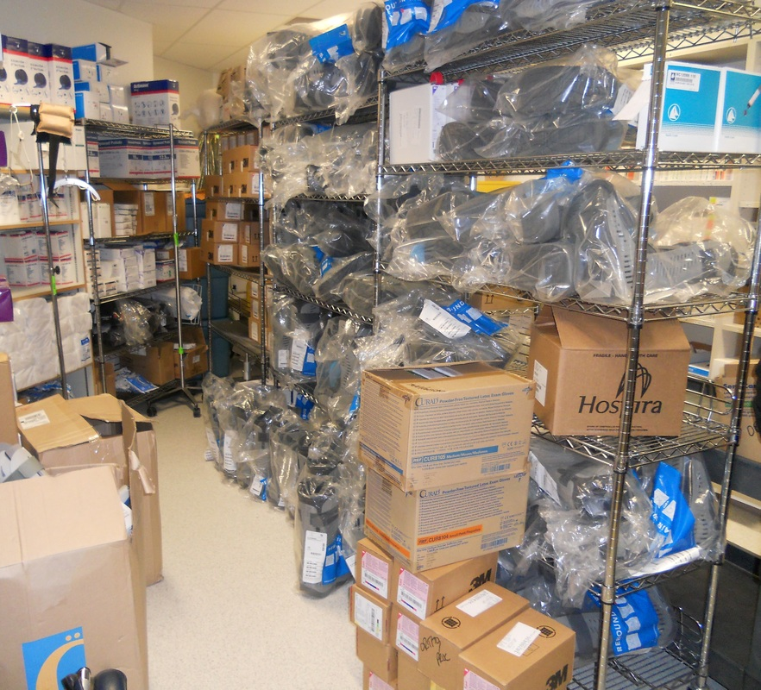
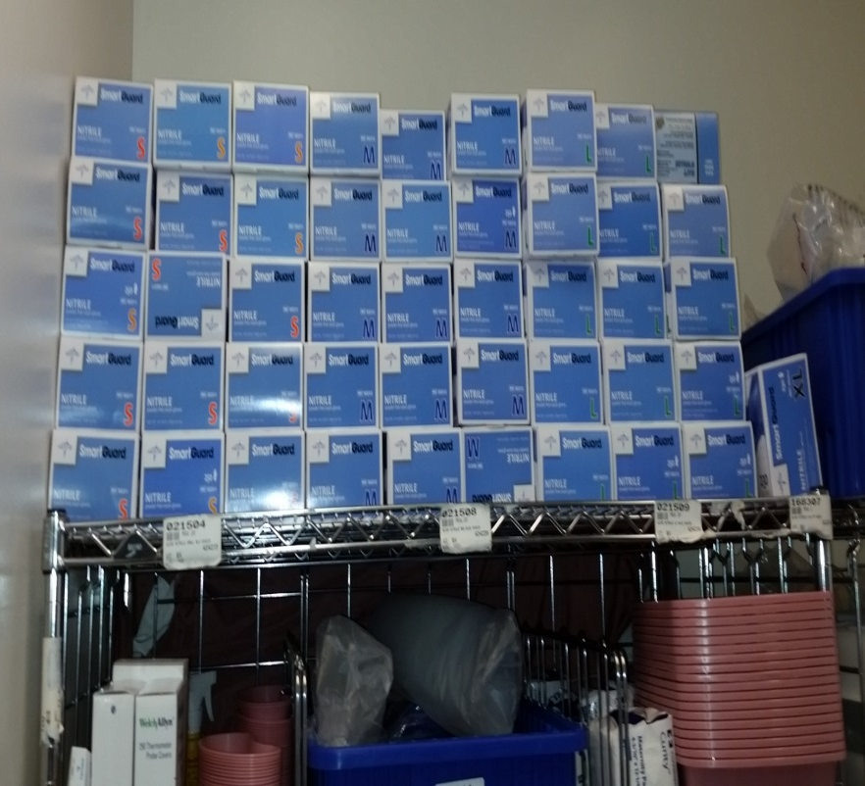
Lean
Define Value - The 8 Wastes
Inventory - Stockpiling
  Dictation ready for transcription.
  Testing Schedules.
  Supplies or paperwork sitting unused.
Notes:
List the INVENTORY waste examples that are discussed: Ask for examples in Patient Access (old forms or scanned items that you can’t quite let go of)
Examples:
Broken machines
Broken beds
Emails
Extra materials taking up workspace
Food
Paperwork in “in” boxes
Partially completed tasks
Patients in exam rooms
Printed forms that become outdated
Supply rooms that are overstocked
Inventory Definition – Inventory or information that is sitting idle (not being processed).

Slide 14
Lean
Define Value - The 8 Wastes
Motion – People movement
  Unnecessary and excess movement of people.
  Excess motion while performing procedures/processes.
ED Flow Green Belt Team - Spaghetti Diagram
Notes:
List the MOTION waste that is discussed: Explain the spaghetti diagram and defer to Lori on the specifics of this diagram project
Examples:
Bending
Leaving the patient’s room to document
Lifting
Searching for information
Searching for supplies
Searching for tools
Twisting
Walking
Motion Definition – People, information or equipment making unnecessary motion due to workspace layout, ergonomic issues or searching for misplaced items.

Slide 15
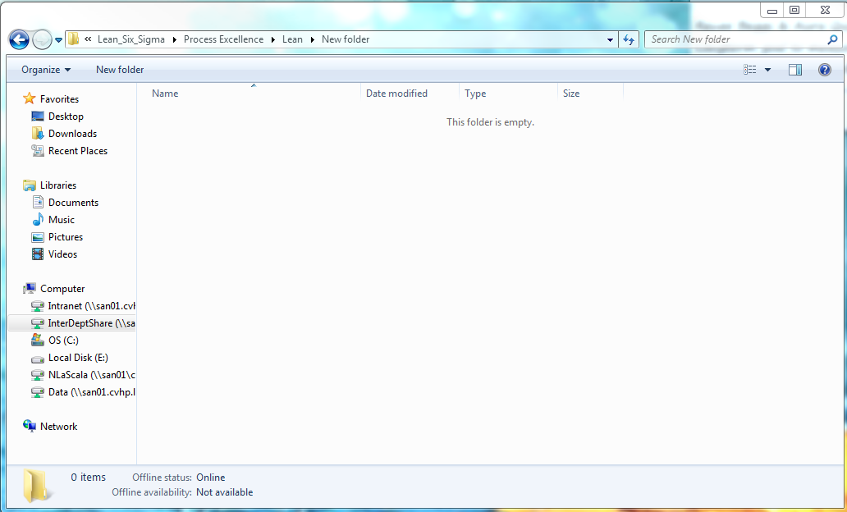
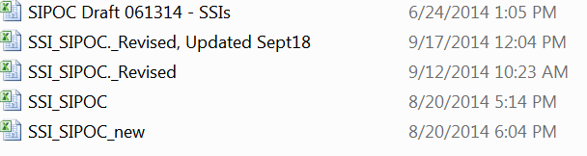
Lean
Define Value - The 8 Wastes
Extra Processing – Redundancy & Re-work
  Data collection that is never used.
  Sample re-testing.
Notes:
List the EXTRA PROCESSING that is discussed: explain shown example and ask for Pt Access examples (rework of pending authorization accounts by several people the same day?)
Examples:
Asking the same question multiple times
Data collection that is never used
Date/Time stamp on orders never used
Extra steps to correct avoidable mistakes
Food sent back due to errors, needs to be re-worked
Hand-off communication requiring multiple calls
Inspections
Multiple drafts/versions of the same report
Duplicate billing that must be reversed
Extra Processing Definition – Performing any activity that is not necessary to produce a functioning product or service.
Interesting Lean Term
Hidden Plant - Hidden Plant, or Hidden Factory, is a term coined by Quality guru Amand Feigenbaum to point out the often un-tracked waste of rework. He discovered that up to 40% of the capacity at a typical manufacturing plant was spent on fixing what was not done right the first time.

Slide 16
Lean
Define Value - The 8 Wastes
Muda (Waste)
  “Needed” or “Enabling” Activity (Muda 1)
  The activity adds no value, but cannot be eliminated based on current state of process, technology, policy or thinking.
  Non Value-Added Activity (Muda 2)
  Consumes resources but creates no value to the patient.
  Pure waste - if this activity is removed, the process can continue.
    The 8 wastes are non-value added activities and should be the first eliminated.
Notes:
Remember I said we would discuss MUDA later on…it’s now later on ( this is when we choose a “fix what bugs you” problem for the presentation IMPORTANT CONTROL THE CONTROLLABLES. If none then we will generically use “agitated patient”)
List your departments MUDA 1 wastes here:

Slide 17
Lean
Defining Value - Voice of the Customer
Discover & Refine
Second Step:
Focus on the Customer’s
Point of View

Slide 18

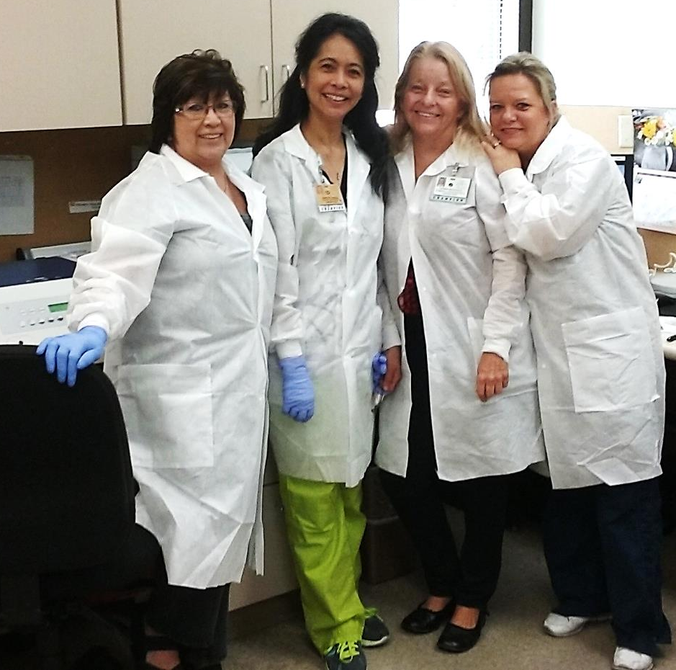



Lean
Defining Value - Voice of the Customer
What is a Customer?
  Any person or company that gets a product or service from the work that we do.
Notes:
Note: Worksheets in this manual can be found on the Intranet A:\Intranet\Lean Certification Forms
List who our customer is for chosen problem or “agitation”.

Slide 19

Lean
Defining Value - Voice of the Customer
What is the Voice of the Customer?
  Your customer’s needs and the perception of your service.
  Customers decide if your process is effective.
  Your process design should focus heavily on your customer’s requirements.
Notes:
Customer Value Worksheet: point out VOC questions
Note: Worksheets in this manual can be found on the Intranet A:\Intranet\Lean Certification Forms

Slide 20
Lean
Defining Value - Voice of the Customer
Obtaining the
Voice of the
Customer
Direct
Interviews (Phone calls or in person)
Focus Groups
Indirect
Complaints
On-site Observation
Surveys
Behavior Patterns
Competitor’s processes.
TIP
Indirect methods can yield more honest information
Notes:
Voice of the Customer Sample Questions
Tip 1: Use a ranking system for some of these questions. Have customers rank them in order of importance or occurrence (i.e. never, sometimes, usually, always)
Tip 2: This information can come to you directly or indirectly. Remember to use complaints as VOC feedback too.
What is important to you about the service we provide?
The staff understands my needs.
How would you rate the quality of the service we provide?
How would you rate the speed in which we deliver our service to you?
I am likely to recommend your service.
How are we performing in areas that you consider important?
What do you consider a defect or mistake?
What do you like about our services?
What were your expectations of what our service would be?
What can we do to improve our services?
What can we do to make your job easier?
Do you know of new or different equipment/tools that would help you in your daily work?
Do you know of an improvement to the current process that might work here at CVHP?
What specific recommendations would you make to us?

Slide 21
Lean
Define Value
Gather ideas and information for your project
Third Step:
Discover the “Current State” Organize your information and find the root cause
Notes:
The fun part: find the ROOT of the problem

Slide 22




Lean
Define Value - Process (Gemba) Walk
Any Process Has at Least 4 Versions…
What YOU think it is…
What it REALLY is…
What it SHOULD be…
What it COULD be…
Notes:
Gemba Walks Lead to Understanding
How do we get to what it REALLY is, the REAL PROCESS? DATA!
Systemic thinking is closely related to the principle of Focus on the Process. Similarly, these two principles are closely related to key business systems such as goal alignment and Gemba walks. In order to achieve Departmental goals successfully, it is necessary to ensure that the whole staff understands and are committed. Achieving shared goals requires good data, good analysis and discipline.
The related principle of Focus on Process teaches, “Good processes make successful people.” A regular and disciplined process of visiting the Gemba provides the breadth of understanding required for leaders and managers to make good decisions. Seeing firsthand the interactions between related sub-systems helps in diagnosing the difference between actual and ideal behaviors and can reveal whether or not people are using the right data to manage the business and drive improvements.
4 Versions of a Process
What YOU think it is – Making assumptions that the process is happening in a certain way.
What it REALLY is – What is actually happening in the process. The goal of a Process walk is to get everyone from what we think it is, to what it actually is, together.
What it SHOULD be – Comes from Policy and Procedures that nobody is following. Why is that? Do they need to be updated or re-written?
What it COULD be – The version the team will come up with for the project. A version that is more effective and efficient.

Slide 23

Lean
Define Value - Process (Gemba) Walk
Gemba means “go to the real place”
A process walk is used to discover what a process looks like in its current state.
Notes:
Visiting the Gemba provides the understanding required to make good decisions. YOU DON”T KNOW WHAT YOU DON”T KNOW!
The best decisions are made when there is awareness and knowledge of the different elements of a system, as well as how these elements are interconnected and what the outputs of the system are.
Thinking systemically improves understanding by learning to see the system as a whole, including elements sometimes called sub-systems. In reality, most things are connected to something else in an environment that is constantly changing.
The Human Body as a System
A clear example of an integrated and complex system is the human body as it is composed of different sub-systems such as the digestive, circulatory or nervous systems. Each of these sub-systems performs a function while being interconnected with the others, and only its synchronized and balanced function enables the entire integrated system, the human body, to perform perfectly.
Likewise in companies, an integrated system is composed of sub-systems that working together will enable the organization to achieve its best outcome. Sustainability comes through understanding the interconnections.
Discuss Silos: IMPORTANT, WE DON”T KNOW WHAT WE DON”T KNOW
Understanding of the relationships and interconnections of elements of a system makes better decision-making possible and creates visibility to improvements. Systemic thinking encourages improvements to be made on the system as a whole, rather than individual components of the system, which is often where the ideas for change are initiated.

Slide 24
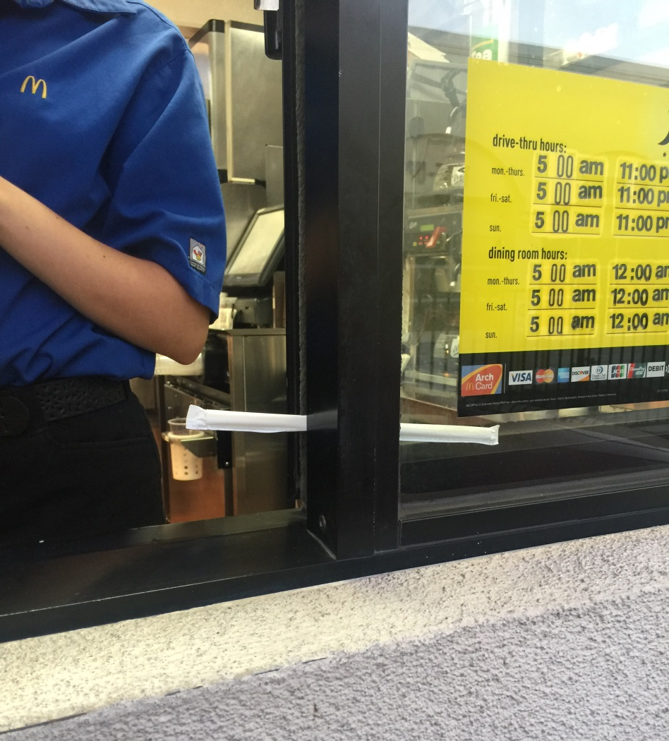
Lean
Define Value - Process (Gemba) Walk
Goals of a Process Walk:
See how the work is actually being done (discover the current state)
Develop a deep understanding of the process
Map every step and handoff taken in the current process
Determine what to measure to get a baseline for current operations
Identify possible waste and root causes for defects
McDonald’s Work-Around
Notes:
Process (Gemba) Walk Do’s and Don’ts : Don’t presume anything: watch, ask, record
Do
Involve both people who do the actual work and leadership such as supervisors, managers, or directors.
Meet with people who work in the process in advance. Begin to build an idea of how the entire process works before you go on the Process Walk. This will help you decide who you will need to meet with during the walk.
The team must be sure to send out invitations with timelines to the department(s), people, and leadership in the department being examined. Be specific about how and when each person will be involved with the Process Walk.
Determine what information will be measured and gathered before performing the Process Walk.
Focus on the process, not the people working with the process.
Be a student of the process and take a learning approach.
Ask those involved in the process “5 Whys” in order to get to the root of the issue. Use the 5 Whys tool.
Remind Process Walkers that they are there to build expert knowledge of how the process is being done in its current state.
Bring sticky notes to record – Aha’s, Potential Opportunities, and Potential Solutions.
Don’t
Don’t bring a copy of the Policy and Procedure with you on the Process Walk. The purpose is to discover how it is being done now in its current state, not to point out what isn’t being done correctly. “Work arounds” can be a hint at a part of the process that isn’t working or needs to be looked into further.
Do not correct the interviewees during the Process Walk or point out where they are not following policy.
Don't separate the team during the Process Walk. All interviews and inspections must be done together so that the entire team can gain understanding of the process.
Don't get caught up in the exceptions of the process. You are only interested in what happens 80% of the time.
Don't start brainstorming solutions during the Process Walk!

Slide 25

Lean
Define Value – Fishbone Diagram & 5 Whys
Why “5 Whys”?
    Simple tool that helps identify the root cause of an issue.
    Helps us to see the relationships.
    Is best used when issues involve human factors and interactions.
    Assists with solving day-to-day problems.
Notes:
Note: Worksheets in this manual can be found on the Intranet A:\Intranet\Lean Certification Forms
Problem: One of the monuments in Washington D.C. is deteriorating.
Why #1 – Why is the monument deteriorating?
Because harsh chemicals are frequently used to clean the monument.
Why #2 – Why are harsh chemicals needed?
To clean off the large number of bird droppings on the monument.
Why #3 – Why are there a large number of bird droppings on the monument?
Because the large population of spiders in and around the monument are a food source to the local birds
Why #4 – Why is there a large population of spiders in and around the monument?
Because vast swarms of insects, on which the spiders feed, are drawn to the monument at dusk.
Why #5 – Why are swarms of insects drawn to the monument at dusk?
Because the lighting of the monument in the evening attracts the local insects.
Solution: Change how the monument is illuminated in the evening to prevent attraction of swarming insects.

Slide 26
Lean
Define Value – Fishbone Diagram & 5 Whys
Discovering Root Causes with the 5 Why’s
I take a lot of pride in making my lawn look good. I don't hire a yard service, I do the mowing, fertilizing, edging, raking, myself. I was dismayed to discover that our dog, Coco, had begun digging in the yard, and there were bad patches everywhere.
My first thought was that we had to get rid of the dog. How would I explain that to the kids?
Why did the lawn look bad? - The dog was digging it up.
Why was Coco digging it up? - Because she was trying to get at the moles.
Why were moles in the yard? Because they like the ready supply of grubs.
Why are there grubs in my beautiful yard? They are attracted to the new fertilizer.
Why did I switch to a new fertilizer? I thought it would make my yard look better!
5 whys have saved Coco and my yard. I've gone back to my old fertilizer, which it turns out is cheaper anyway.
Notes:
Notes: You’ll find a 5 whys in your packet: I 5 why everyone who comes in with a complaint. It gets them to be a part of the solution and think beyond just the complaint issue.
“Money was taken from my purse”
Why do you think this happened
“My purse was at the front desk”
Why was your purse at the front desk
“I didn’t put it in a locker”
Why didn’t you put it in a locker
“I wanted to save time when leaving on my break so I could go shopping”

Slide 27
Lean
Define Value – Fishbone Diagram & 5 Whys
Fishbone Diagram
  A visual tool that can help you organize some of the possible causes that you found on your Process Walk.
  Problems are arranged under their “theme” to help drill down details regarding the cause.
  Assists the team in having a common understanding of the causes and can help get to the root of the problem.
Notes:
Note: Now that we identified what bugs us, we have the VOC and we’ve done our Gemba walk, we need to process the information that we have gathered. We have several tools let’s start with the fishbone diagram

Slide 28
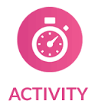
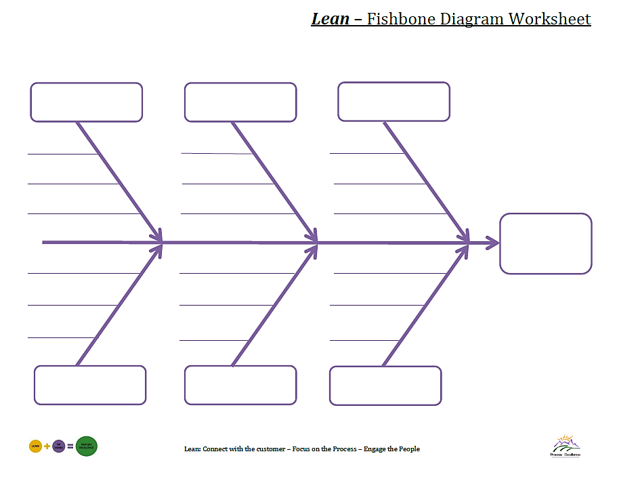
Fishbone Activity
Notes:
Possible Fishbone Diagram categories could include:
Policies
Layout
Forms
Process
Systems
People
Equipment
Materials
X
X
X
X
X
X
X
X
X
X
X
Y
LITTLE ISSUES FEED THE

Slide 29
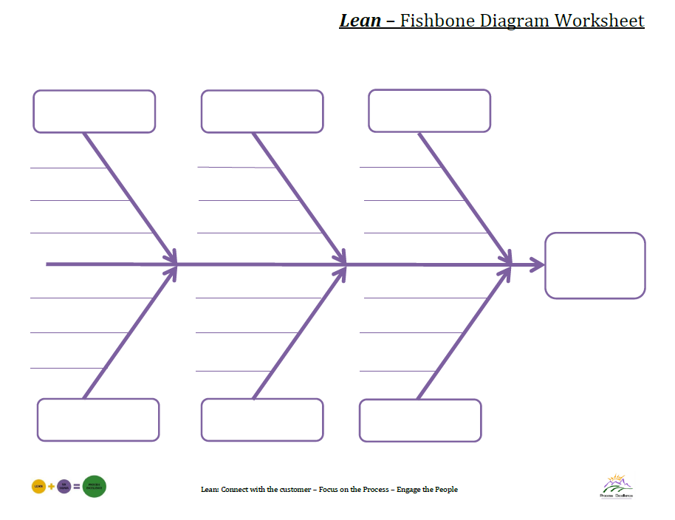

Lean
Define Value – Fishbone Diagram & 5 Whys
The problem we are trying to resolve is written in the head of the “fish”
People
Environment
Patient Factors
Family
Lighting
Age/Sex
RN
Noise
PM History
Other
Visiting hours
Diagnosis
Agitation
Side effects
Computer System
Progress notes
NG Tube
IV Pumps
Rounds
Catheter
Phones
Drugs & Devices
Technology
Communication
Notes:
Brainstorm other things that might be a source of agitation for the patient.
Notes:

Slide 30
Lean
Pursue Perfection
Organize your project
Fourth Step:
Measure &
plan your improvement.

Slide 31
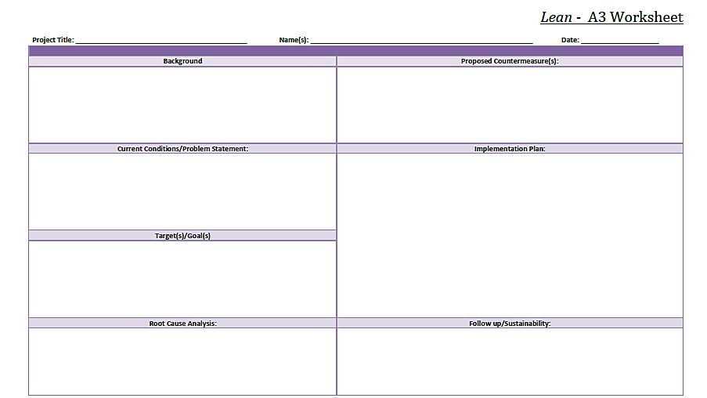
Lean
Pursue Perfection – The A3 Worksheet
A3 sections
Notes:
Lean – A3 Do’s
1. Focus on the problem solving, not creating a great presentation.
2. Consider the background, the issue, the goals, the people, the timeframe, and the root cause analysis.
3. Include pictures, videos, and graphics. They are strongly encouraged.
4. Handwritten A3s work. Write in pencil so that you can make changes as you work on the problem.
5. Establish the countermeasures, run the test, and troubleshoot.
6. Be sure that each iteration or change is small and can be completed quickly.
7. Make a good plan but don't waste time making it perfect. The idea is to learn from each cycle.
8. Discover who will be impacted by the change and establish stakeholder support - engage the people.
9. Involve other departments if they will be affected by your changes.
10. Stay present and involved during cycles. Be available in case things don't turn out as planned.
11. Include process improvement missteps, oversights, miscalculations, and shortcomings in the next cycle of improvement.
12. Plan to test during different process conditions, look to introduce natural process variation.
13. As a current cycle closes, the next cycle undertaken can be slightly more complex. Allow each cycle of improvement to build upon the last.

Slide 32
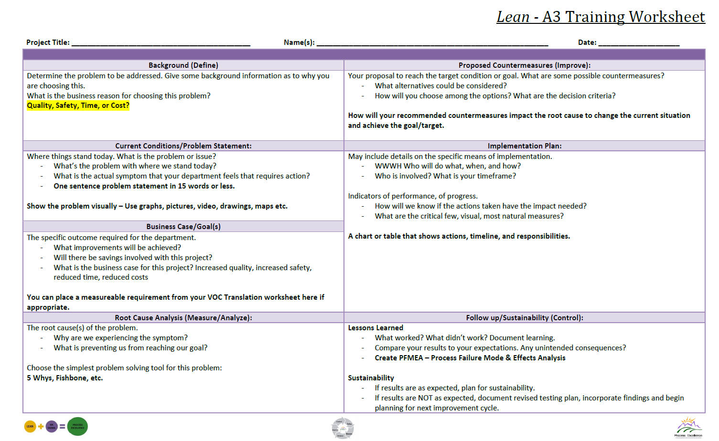
Lean
Pursue Perfection – The A3 Worksheet
Notes:
Lean - A3 Don’ts
1. Don’t try to fix problems in departments other than your own. There are plenty of opportunities where you are working.
2. Don't go solo. Solutions can't be implemented by one person so be sure to include colleagues in your planning.
3. Don't skip the root cause section. Countermeasures are the goal but you must ensure you are addressing the root cause to make a valuable improvement.
4. Don't use the word solution. Rather than saying a problem is solved or that you have found a solution, use the word countermeasure to show that you have found the best improvement until a better approach is found or conditions change.
5. Don't skip the follow-up section of the A3. It's the most important section to work on in order to sustain your gains.

Slide 33
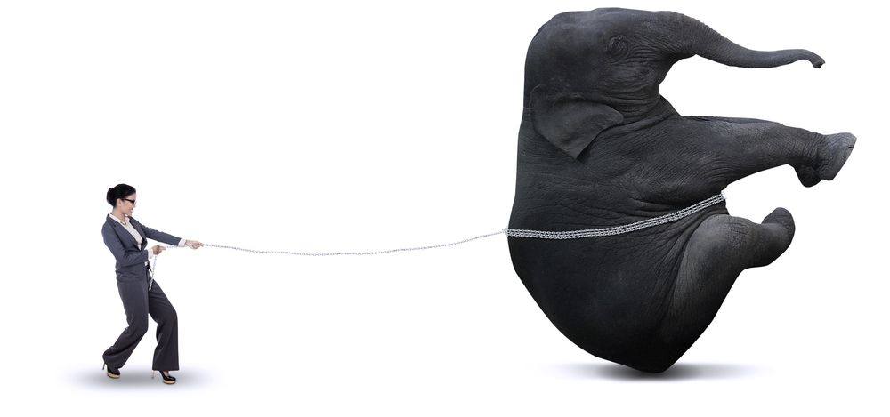
Lean
The A3 Worksheet
Section 1 – Background (Define)
  Why is this a problem?
  What bugs you about the current state?
  What makes this project worth working on?
  How did we get here?
Notes:
Notes:

Slide 34

Lean
The A3 Worksheet
Section 2 – Current State/Problem statement
  15 word statement that defines the problem and focuses on exactly what you will be working on.
Notes:
Notes: Limit yourself. DON’T BOIL THE OCEAN

Slide 35
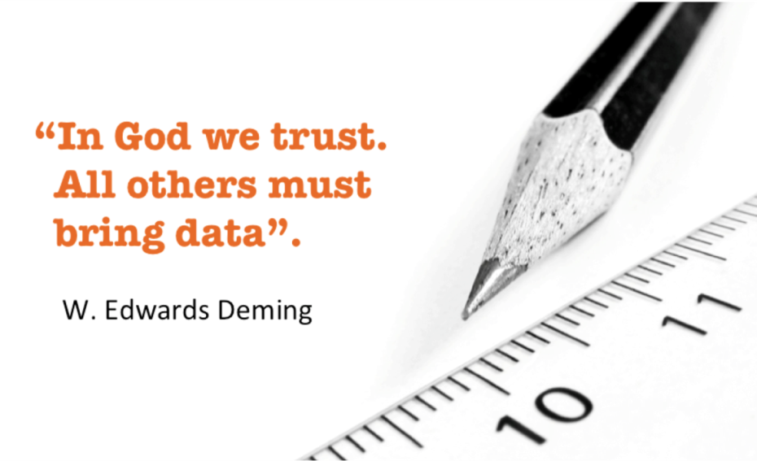
Lean
The A3 Worksheet
Section 3 – Business Case/Goals
  Determine what you will measure for your current state.
    How much time it currently takes to perform a task?
    How much money you are spending that is wasted?
    How much inventory is being thrown away?
    How often must you fix a mistake?
    Current survey results?
    Employee turnover?
    Number of defects?
    Patient satisfaction?
Notes:
Notes: State your business case for back up. Show the $$. It all translates into $$.

Slide 36

Lean
The A3 Worksheet
Section 4 – Root Cause (Measure)
  Results of your interviews and GEMBA walks.
    What is the current process telling you?
    What is feeding into the mistakes/waste?
    What is the behavioral culture surrounding the current state of affairs?
  Ah Ha! Moments.
    Wow! Didn’t realize that was happening.
Notes:
Notes: YOU DON’T KNOW WHAT YOU DON’T KNOW! Bring up quick wins (ER Flow were leaving AMA, not LWBS: Departed incorrectly).

Slide 37
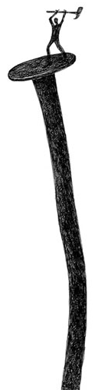
Lean
The A3 Worksheet
Section 5 – Countermeasures (Improve)
  What specific countermeasures will address the root of the problem?
    Can this be accomplished immediately or will it need to be done in stages?
  Plan for measuring the “after” state.
    Who will perform the measuring?
    Is the criteria for measuring the same as before?
Notes:
Notes: Start to fix “What Bugs You!”

Slide 38
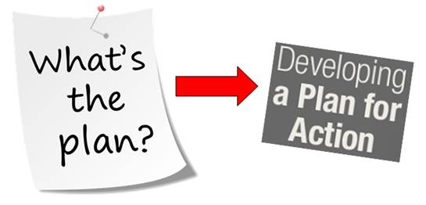
Lean
The A3 Worksheet
Section 6 – Implementation Plan
  Which tasks are specifically assigned to whom?
  On what days/times will each step be performed?
  Begin measuring after plan implementation.
    Does it take less time?
    Are you measuring less mistakes?
    Did you lower costs?
    Have the survey results improved?
    Are your colleagues happier with the improvements?
Notes:
Notes: Show your improvement! CELEBRATE!

Slide 39

Lean
The A3 Worksheet
Section 7 – Sustainability (Control)
  If you win the lottery tomorrow, will your new process live on?
  Have you created plans to address updates or changes?
  Plan to continue to measure results.
Notes:
Notes: Pass it on to the stakeholders of the process.

Slide 40
Lean
Standard Work
A Stable Base
Fifth Step:
Standard Work
as Part of a Process Solution
Notes:
Notes:

Slide 41
Lean
Standard Work
Standardization and Standard Work
  Establishes the “standard” by which all work is done.
    Includes Best Practices, Standards, and Procedures.
  Forms a strong base for continuous improvement.
  The focus is on improving the standard.
  Launches creativity
  “It’s all about identifying and improving on the standard work and applying that standard work every time for every patient.”
  Charleen Tachibana
  RN, Senior Vice President, Hospital Administrator and Chief Nursing Officer Virginia Mason
Notes:
Benefits of Standard Work:
Reduction in variation.
Simplifies training process for new hires.
Documents the current process.
Establishes a baseline for improvement efforts.
Increases the discipline of the culture.
Supports regular process audits.
Stimulates collaborative problem solving.
Mistake proofing is developed.
Employee engagement- standard work involves team members in making their work life easier.
Practice in your Department:
List processes that are currently standardized in your department.
List processes that could be standardized.
Compare the current process to industry best practice.

Slide 42
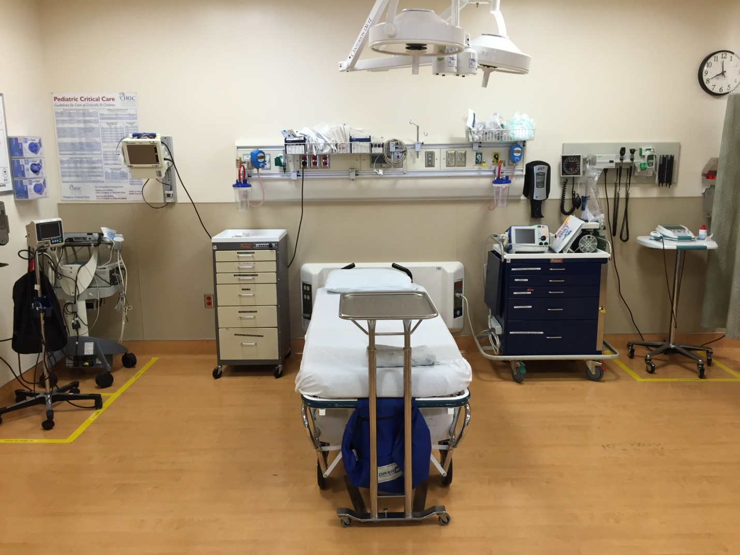
Lean
Standard Work
Standard Work How To
  Make common procedures and processes easy to perform.
  Create effective visual aids, point-of-use checklists, templates, job instructions.
  Launches creativity – The goal is not mindless conformity. Thought and energy is saved for more important work that people must do.
Notes:
Look at the picture in the slide. How has Standard Work been used in the FPH ED?
Notes:
Build your process around:
Standard processes based on data & best practice
Pull systems
Uninterrupted flow
Value
The Voice of the Customer

Slide 43

Lean
Standard Work
Standard Work Sustainability
  Create Standardized steps that can be tracked and audited.
  Help staff form new habits!
  Standard Work must be documented and tested.
  Continuous evaluation, audits, and adjustments to the work.
Notes:
Notes: DATA, DATA, DATA! Seeing is believing
Be very specific when developing a sustainability plan for standard work.
How often will you audit the new process?
On which day?
What actions will you take if you are not satisfied with the results of the audit?

Slide 44
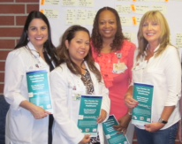

Wave I Green Belt Project
ED Flow – “The A Team”
Team: Lori Bryant, Director, Admitting/Registration, Sheryl Claveria RN, House Supervisor, Darlene Coker, CLS, Director of Laboratory, Lolly Henderson, Director, Emergency Department
Problem Statement: A Significant number of patients seeking medical treatment in the Emergency Department (ED) at Foothill Presbyterian Hospital (FPH) leave without being seen which negatively impacts our communities health.
Notes:
Bring together staff from other departments: ask why, why, why because they don’t think they know why. Creates networking for future projects. Problem always stated: Write it down. Don’t lose sight of it. Don’t Boil The Ocean.

Slide 45
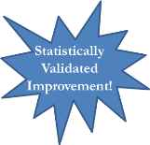
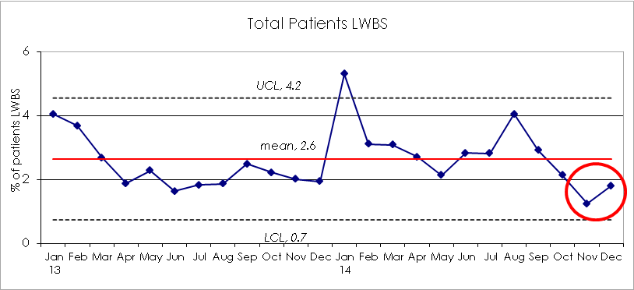
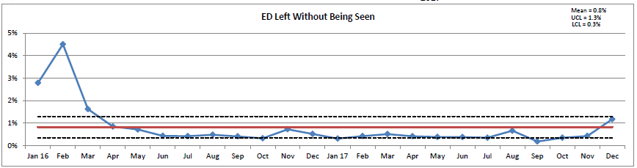
Wave I Green Belt Project
ED Flow – “The A Team”
Continued sustainability – SUCCESS!
Targeted Solutions
Improved/streamlined workflow in ED
  Midlevel provider performing IEC in triage
  Double triage when greater than 3 patients waiting
  Reallocate nursing staff hours to manage front-end flow
  Education, re-training and weekly reports to track timeliness
Waste reduction in motion and transport
  New location for ED charts, racks and assignment board; relocation of linens, sharps containers and disinfectant holders

Slide 46


Control the controllables!
Don’t boil
The ocean!
Keep
Calm
and
Carry
On
You don’t know what you don’t know

