Slide 1
Decreasing Patient Access Denials Through Education and Innovative Tools

Slide 2
Topics
Registration QA Application Improvement
Work Queues
Work Groups
Eligibility Denials
Patient Estimate Quality Review
Education and Reporting

Slide 3
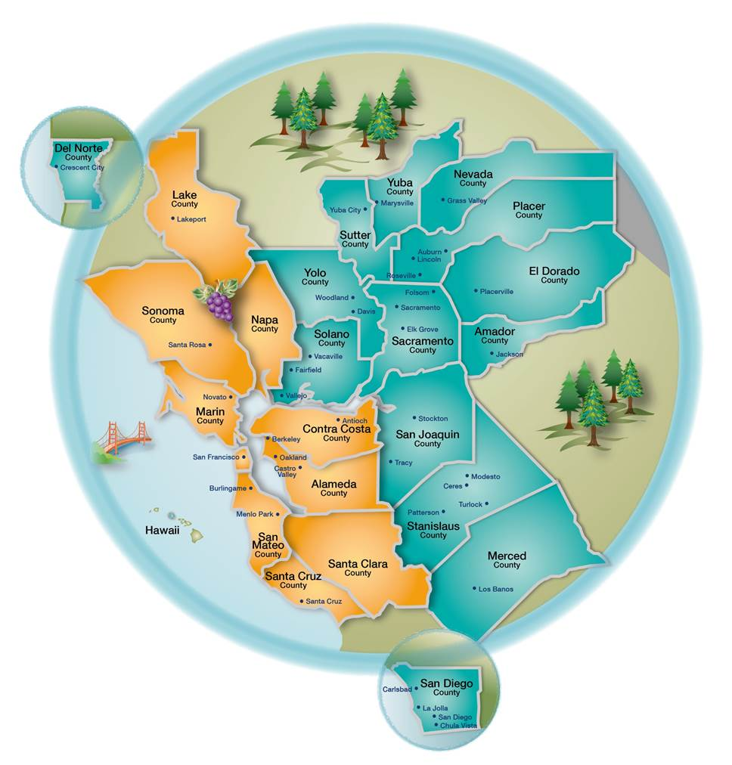
Sutter Health at a Glance
Care Centers
24 Acute Care Facilities
Employees
53,000 Total Employees
1,872 Revenue Cycle Employees
Patient Access Applications
868,837 ER Visits per year
31,780 Births per year
250,000 Claims Processed per Month
995 Patient Access Employees
PaymentSafe
RQA
FAS
PPE
eCareNEXT
Sutter EHR
RTE
“Bolt-on” Applications

Slide 4
Registration Quality Assurance (RQA) Improvement
Interface issues between Sutter EHR and RQA application – Resolved May 2017
Corrected message between the A31 and A08
Moved content into A08 for system to recognize data and resolve alerts
Quality control issues with mapped and unmapped users
Lack of an auditing system to track on boarding/transferring staff
New quarterly active user report in development
Migrated to sDoc platform in order for the alert to stop firing on Physicians, Nurses, and other unmapped users
Customized alerts based on needed exclusions (e.g. location)
Alerts
Actively removing redundant alerts between Sutter EHR and RQA tool
Turned off the two highest occurring alerts due to the Sutter EHR address linking feature
Created and refined new rules
Medicare supplement plan
New WC Alerts
Simplified alert names to clarify the route to resolution

Slide 5
Work Queues
Modified the My Unresolved work queue alerts to 72 hours
Created the Catch All work queue as an improvement on the All RQA Alerts MTD
Captures alerts associated with account rather than the user
Standardized work queue workflow and priorities
Created pre-service work queues to separate pre-service accounts from arrived encounters
Created new alert to flag pre-service accounts
Proactive resolution to account errors
Excluded cancelled appointments

Slide 6
Work Groups
RQA Application Work Group
Required RQA application vendor and Sutter Information Systems participation at every meeting
Consists of Managers, Supervisors, Sutter Information Service Analysts, and QA staff members
Discuss common issues/problems staff are encountering with the tool
Meetings frequency changed from monthly to biweekly
Revenue Cycle Denials Work Group
Including participants from all areas of Revenue Cycle to address eligibility denials
Close the “gap” between eligibility denials and registration accuracy tool
RQA Tool Vendor Representation, Sutter IS, Education and Training, Patient Access, Central Business Office, and Revenue Cycle Integration

Slide 7
Eligibility Denials
Plan mapping in Sutter EHR and real time eligibility vendor
Bad plan code alerts completed for all major payors
Currently developing reporting on bad plan mapping to assess impact
Created/modified alerts to reduce denials
Improved logic on alert “Date of service occurs after termination of benefits” to increase capture of termed insurance
Resulted in an immediate 1% drop in 1st Pass Denials (30 days)
Turned on alert “Inactive insurance on account” to capture inactive coverage on account
Currently developing new alert to capture active coverages left on guarantor/patient level and not attached to account
Impact on Revenue KPI
13% improvement on clean claims (Q1 2016 – Q3 2017)
Reduced 1st Pass denials 2.3% (Q1 2016 – Q3 2017)
First pass accuracy 90.74% → 96.50% (Sept 2016 – Sept 2017)
Final pass accuracy 97.37% → 98.90% (Sept 2016 – Sept 2017)

Slide 8
Patient Estimate Quality Review
Touchless Estimates
Piloting in ER
No staff intervention required
Estimate Variance Report
Review trends
Reduction of workflow variances
Designed refresher workshops
Individual user review

Slide 9
Education and Reporting
Created a real-time Sutter EHR/RQA application training environment
Interfaces built between Sutter EHR training environment and RQA application
Provides realistic results and workflows for RTE, RQA, PPE, and Payment Safe
Power Reporting Portal
Payment Opportunity Report
Provides useful data for proactive education of staff to prevent errors
Utilize the RQA scorecard feature to track individual employee scores
Reporting tool provides near real-time data
Requested enhancement for informational alert reporting
New employee training
Created structured curriculum for RQA and PPE training

Slide 10
Contact Information
Doug Nowotenski – Patient Access Manager
NowoteDD@sutterhealth.org
Suzanne Payne – Training Analyst Revenue Cycle Education Team
Ctpayns@sutterhealth.org

