Slide 1
Improving Engagement through Employee Led Innovation
CAHAM
AUGUST 2018
Becky Peters, Executive Director
Banner Health

Slide 2
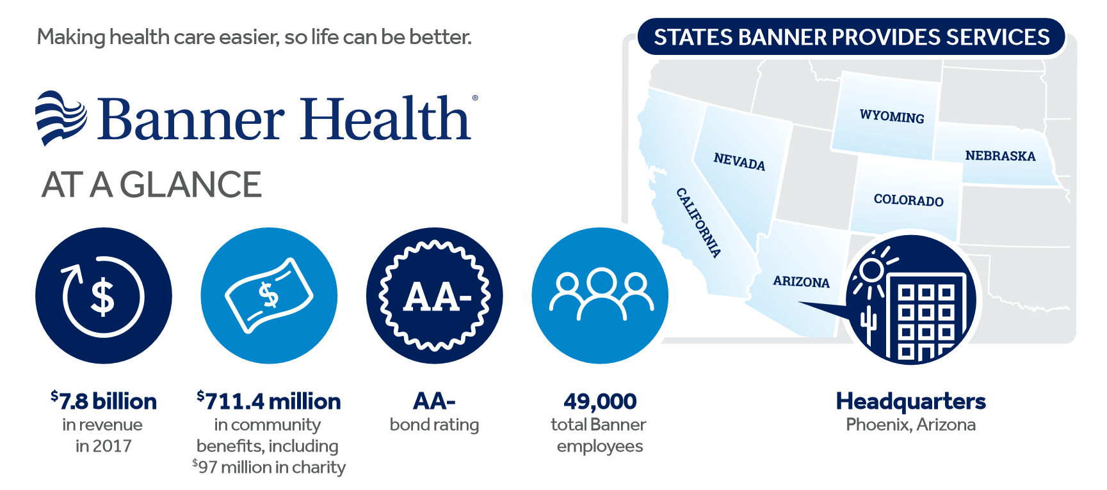
Banner at a Glance

Slide 3
Banner at a Glance

Slide 4
Objectives
Understanding what your employees need in order to get and stay Engaged
Developing Transparent Communication/feedback
Empowering Staff to be the change they want to see

Slide 5
Which group do You Have
Low Morale/Low Engagement
Positive Morale/High Engagement
Lack of trust
Low Performance
Staff led Change
Trust in Organization/leaders
Clean hand-off’s
Improved Performance
Resistance to Change
low turnover
Variance redundancy
Invested staff/Career Growth
Unhappy Customers
Happy Staff/Customers
High turnover…
Negativity/conflicts
Standard & streamlined workflows
Notes:
At Sutter Health we take the patient experience serious and consider every touch point an opportunity to create a high quality experience. Prior to leveraging the many tools Experian has to offer, patients had a completely different and very disconnected experience when it came to billing and liability. There were severe delays in the time it took for patients to receive there bill, we either did not have estimates or estimates were labor-intensive requiring staff to do significant amounts of research. Patients would call in for benefit information and depending on who they spoke to would receive a variance in responses. Estimates were primarily based on total charges, not the patient’s liability. We only accepted cash or check at point of service and our request for payment was often met with a response like, “I left my wallet/checkbook at home”, “ I didn’t want to bring my purse to the hospital while I was in surgery”. Wait times on applications were long and required supporting documentation. And worst of all, patients didn’t find out what they owed until they got the bill in the mail…months later! So, at Sutter we made a decision to create not only a great patient experience during your hospital stay or clinic visit, we invested in Experian’s suite of tools that supports the culture we wanted to instill. Today we have timely, quality billing. Our Foundation has a patient facing portal and we have a shopper estimate call in group. E-Benefit information is imported into our EHR. Estimates are based on benefits, contract rates, and outstanding patient liability. We collect payments securely and electronically over the phone. We offer immediate, real-time financial assistance. And most importantly, our patients have an increased understanding about their benefits and liability that helps them make educated decisions- they have the whole story ahead of time!

Slide 6
Every Day Challenges that impact Engagement and Morale
Organizational Restructuring
New Technology
Divided and Remote workforces
Decentralized processes
Non-standard work
Lack of Recognition
Lack of communication and transparency
Conflicting Leadership styles
Lack of Education/Training resources/funds
“CHANGE” Fatigue
Disparate pay for complex work

Slide 7
Let’s hear from our staff

Slide 8
Bright Ideas for Listening to your Teams
Employee Surveys/ check in’s
Staff Round Tables
Rounding/Huddling
Observations
Staff Meetings
Value Stream Mapping
True Open Door
This Photo by Unknown Author is licensed under CC BY

Slide 9
Hello…….

Slide 10
We heard you
360 Feedback
Connecting the Dots= The What, The Why, The How &The When
Project involvement and SME’s
Career development support
Meaningful Education/Training
Networking opportunities-conferences
Walk in my Shoes/Job Shadowing
Catch up in 5
Certification programs

Slide 11
PAS: Our People Purpose
“To build and foster an innovative culture that promotes: Trust, Respect, Collaboration, Understanding and Success for our Patients, Staff and Customers”

Slide 12
Building a Team that puts the Patient and Customers First “What if I and What if We”
Assume Positive Intent
Embrace New Ideas and views
Be open to giving and receiving Feedback
Be willing to look at things from a different perspective
Walk in another’s shoes
Get out of your comfort zone more often
Share histories to break down barriers
Cultivate understanding-ask Why
Embrace success as a Team- not always about the individual
Take Risks- don’t be afraid to fail
Practice an Open Mind
Be Respectful in all things
Trust
Seek out collaboration
Dream Big & Share

Slide 13
Pioneers of Change Be the Change You want to See
Positivity Pledge
Accountability to each other
Recognition
Employee led committee’s: Welcome New employees, Recognition, Wellness
Leadership development opportunities
Leadership Support
“ We May Not Have It All Together, But Together We Have It All”

Slide 14
Thanks to an Amazing Team!
Kudos and Thanks to the Sutter Pioneer of Change Founders & members: Debbie Braun, LaQuitta Cotton and Jacki Schivo and the rest of the amazing team!
Sincerely,
Becky Peters

