Slide 1
Leveraging Patient Segmentation to Meet Patients Where They Are
Kathie Kirkland, PFS Director, Maricopa Integrated Health System
Erica Franko, Senior Vice President and Managing Director, Advisory Services, nThrive

Slide 2
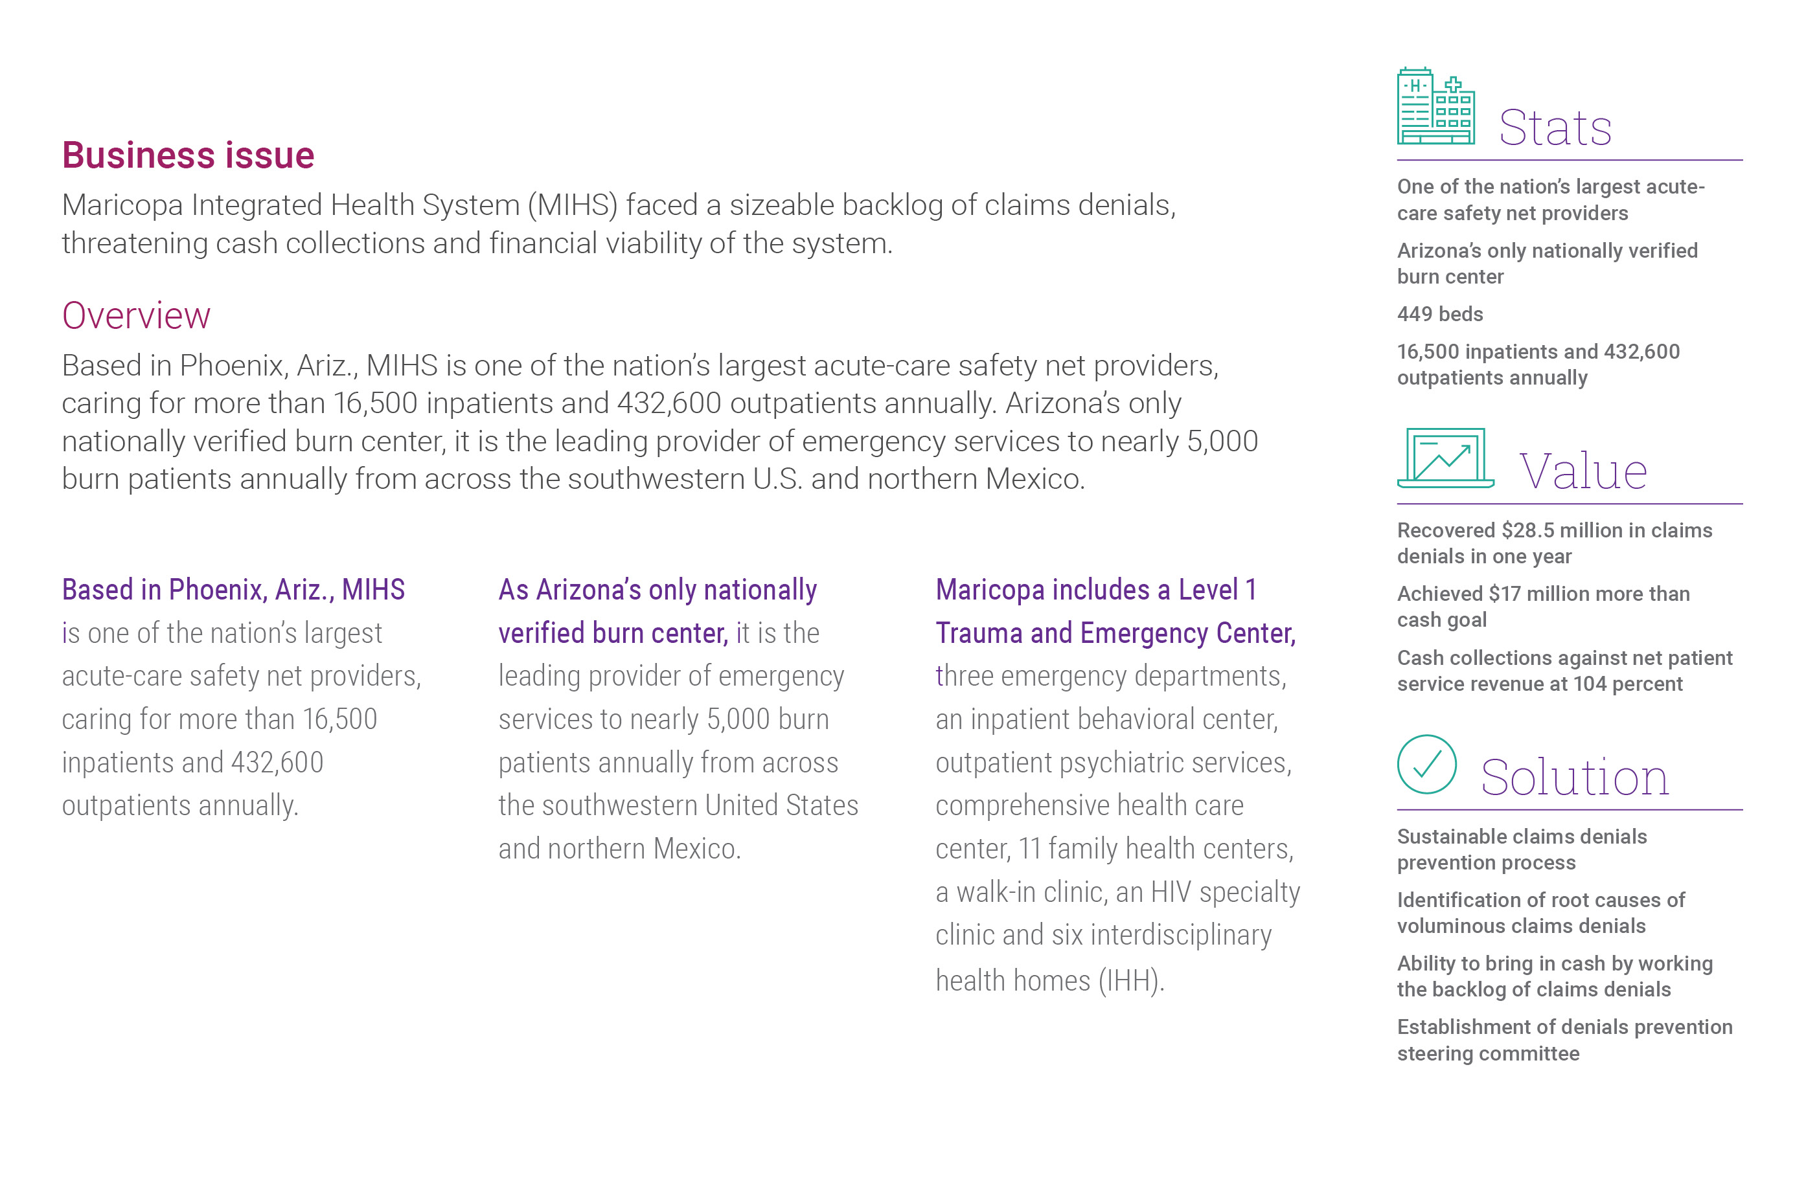
Maricopa Integrated Health System

Slide 3

The Situation
MedAssets
Precyse
Acquired
MedAssets Splits
½ Divested
MedAssets
Precyse
Merge
MedAssets + Precyse
Brand Created
Equation Health / Adriema / e4e
Acquired
Notes:
KS

Slide 4
What is Patient Access?
Patient Access is the start of the
Revenue Cycle value chain
What are the aims of
a successful patient access program?
From contact…
Registration
Eligibility &
Benefits
Address &
ID Verification
Patients are scheduled
with the right provider at
the right time
Scheduling
Call center
ED registration
Insurance
Verification
Patient Liability Estimation
Patients are financially cleared prior to arrival
Patients understand their liability and have an
opportunity to pay
Service Collections
(pre- or point-of-service)
Financial Counseling
…to arrival
Authorization
Patients receive the support
that they want and need on
their journey

Slide 5





Patient Perspective of Patient Access
Access/coverage determination
Each area of interaction impacts what the patient will
or will not receive
as a liability
Post-service account resolution
Estimation of liability/propensity to pay
POS account resolution
$
Enrollment qualification

Slide 6
Which trends align with Patient Liability?
Complex
Reimbursement landscape
Increase in
Patient Responsibility
$
Fate of health reform and alternative payment methods
Shift of the cost burden from payors and employers to patients
If common goods increased at the same inflationary rates as healthcare costs, one dozen eggs would cost about $55
Rise in Health Consumerism
$
Rise in cost
and utilization
Rising patient expectations for customer services in healthcare
Innovations, technology, pharma
and increased utilization (aging population) drive the cost to deliver and cost to collect
Notes:
Growth in health care jobs and utilization has been greatest in ambulatory settings, while inpatient volume has been relatively flat.
The rapid growth of various forms of population health models and convenient care drives toward an environment where health care is available on-demand at all times, in ways which increasingly transcend clinic walls. Many have noted that convenient care does not reduce utilization per se.

Slide 7
What is Patient Liability?
Patient Liability is the amount owed by the patient
for services rendered due to a shift in the cost burden
from payor to patient or to a lack of insurance
Patient Liability impacts
both the insured, underinsured, and uninsured and can
take a variety of forms
  “True Self-Pay”
  Coinsurance
  Deductible
  Co-Pay
Other Words for
Patient Liability
  Self-Pay
  Self-Pay After Insurance
  Patient Responsibility
  Patient Portion
  Cost Sharing
  Point-of-Service Collections
  “What I Owe”
$

Slide 8
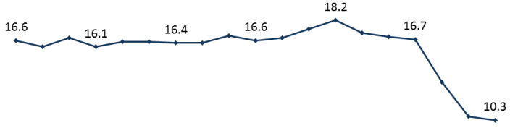
What is Patient Liability?
A conversational history
People are insured—that’s a good
thing right?
Of course, but with some complexity. Let’s think about the old approach—patients or consumers shared the burden of insurance premiums with
their employers, with the employer bearing most of the cost.
1998
2016
The Affordable Care Act (ACA) expanded coverage
to millions of previously uninsured people through the expansion of Medicaid and the establishment of Health Insurance Marketplaces.
Notes:
1. https://www.beckershospitalreview.com/payer-issues/cdc-nearly-40-of-us-adults-have-high-deductible-health-plans.html

Slide 9
What is Patient Liability?
A conversational history
Do we want?
Which brings us to today…
What is a high-deductible health plan?
To put it in perspective, a high-deductible health plan is any plan where the patient is responsible for at least $1,350 as an individual or $2,700 as a family
And it’s not just for the newly insured, the market saw a 3.2% increase in the number of high-deductible health plans offered by an employer
40%
of American adults have a High Deductible Health Plan¹
Notes:
1. https://www.beckershospitalreview.com/payer-issues/cdc-nearly-40-of-us-adults-have-high-deductible-health-plans.html

Slide 10
How does Patient Liability impact our the market?
Changing Payor Mix
Increased Bad Debt
Increased Cost-to-Collect
“Self Pay” is now the 3rd largest payer behind Medicare & Medicaid¹
30% of hospital revenue now comes from patients²
Patient liabilities are more complicated—no longer just co-pays—and include cost sharing arrangements like coinsurance and deductibles
>80% of self-pay bills and 50% of patient responsibilities after insurance end up as bad debt³
A recent AHA survey indicates uncompensated care is a $35.7B industry problem⁴
25% of insured adults (31 million people) are considered under-insured and lack the ability to fund their care ⁵
Patient payments require more resources to collect downstream
Providers can only expect to collect 50-70% of a balance after a patient visit⁶
From patients with high-deductible plans, providers are collecting about $0.18 to $0.34 on the dollar⁷
Notes:
[1] National Assn of Healthcare Access Management; [2] InstaMed, Trends in Healthcare Payments, Sixth Annual Report: 2015; [3] ZirMed webinar; [4] Health Forum, AHA Annual Survey Data, 1990-2016 ; [5] Commonwealth Fund Biennial Health Insurance Survey; [6] Trends in Healthcare Payments Annual Report, 2015; [7] http://www.grouponehealthsource.com/blog/are-you-ready-for-self-pay-patients-in-2016

Slide 11
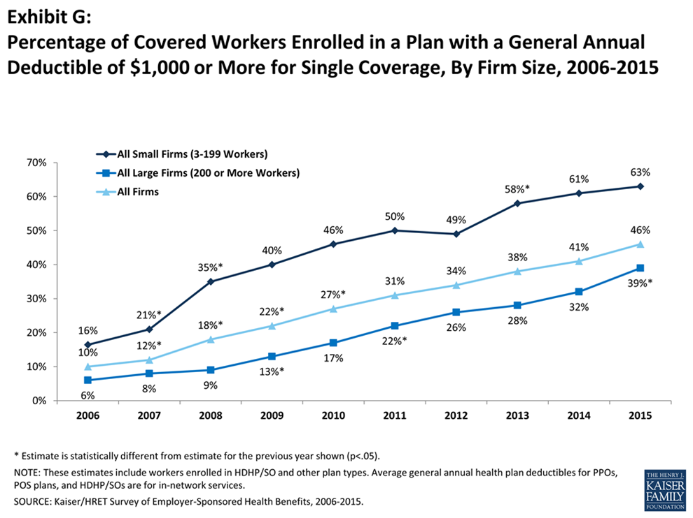
Who pays the bill?
Won’t insurance pay the bill?
Medicare pays an average of 20-40¢ on the dollar
  That means for an office visit of $100, a doctor/hospital will be reimbursed $20-40.
  With all the costs incurred (supplies, salaries, etc.)
  do you think a hospital makes money treating Medicare patients?
Managed Care pays an average of 50-80¢
on the dollar
  That means for an office visit of $100, a doctor/hospital will be reimbursed $50-80.
  With all the costs incurred (supplies, salaries, etc.)
  do you think a hospital makes money treating Medicaid patients?
Medicaid pays an average
of 10-30¢ on the dollar
  That means for an office visit of $100, a doctor/hospital will be reimbursed $10-30.
  With all the costs incurred (supplies, salaries, etc.) do you think a hospital makes money treating Medicaid patients?
Patient Cash varies from
0-30% of charges
  Contractually, insurance companies shift reimbursement (to hospitals) from themselves to the patients.
  Hospital rely on these “Patient Liabilities” to maintain their mission statements (Providing care to the communities, etc.)
  and in some cases, to keep their doors open.
  This amount is rising as high deductible plans become more prevalent

Slide 12
Symbiotic relationship between patient
liability and service level expectations
High level of patient responsibility and high service level expectations
As the cost burden shifts to patient responsibility, the expectation of payment increases…
Patient Responsibility
LOW HIGH
…along with patient expectation of service levels—wait times, customer service, responsiveness
LOW HIGH
Service Level Expectations

Slide 13
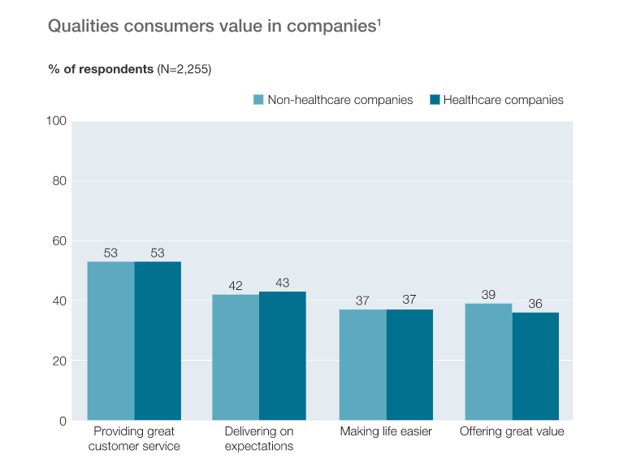
A McKinsey study found that health care consumers and non-health care consumers are aligned on performance expectations
Qualities Consumers Value in Companies
Qualities Consumers Value in Companies
% of respondents (N=2,255)

Slide 14
Patient Segmentation Today
Patient schedules
appointment
Opportunity to optimize workflow and patient experience
No Insurance
Financial counseling if coverage is not provided by patient OR if insurance cannot be verified
Insurance
FINANCIAL CLEARANCE
Verifies insurance coverage, checks eligibility/benefits for scheduled service, obtains authorization and estimates patient liability
Patient pays co-pay at POS or payment plan, charity care, or other plans are created

Slide 15
Consumer-Driven Patient Segmentation
The new age of patient access requires strategies that address the patient as an individual consumer
Patient Engagement
High Touch
Low Risk
High Touch
High Risk
Low Touch
Low Risk
Low Touch
High Risk
Financial/Payment Risk

Slide 16
Patient Engagement in the Revenue Cycle
High Touch, Low Risk
Complex care plan
Complex or incomplete
benefit plan
Secondary coverage enrollment: Disability Enrollment, Managed Medicaid etc
High Touch High Risk
Uninsured patient requiring support to apply for Medicaid, Disability, Charity care and other programs
Underinsured patient with complex care plan and low ability to pay
Patient Engagement Required
Low Touch Low Risk
Simplified care plan
Comprehensive benefit plan
Connected patient preferring electronic and self-service interactions
Low Touch, High Risk
Underinsured patient with ability
to pay
History of non-payment post service
Financial/Payment Risk
Notes:
The new age of revenue cycle requires strategies that address the patient as a consumer

Slide 17
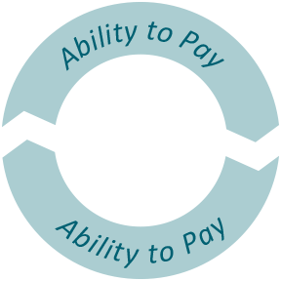
Connecting the Patient Revenue Cycle
Patient Experience
Access/coverage determination
Cash Collections
Post-service account resolution
Estimation of liability/propensity to pay
Productivity
POS account resolution
$
Enrollment qualification

Slide 18
Reduce Cost by Investing in
Advanced Segmentation
Reduce employee turnover through alignment and training of colleagues
Reduce financial risk by addressing liabilities before they become resource-intense to collect
Defer low-touch patients to automatic/digital channels
Utilize high-cost resources effectively through deployment of scheduling algorithms

Slide 19
Contributors to Success
Service Attribute
Impact
Singular focus on helping with bills and insurance | Extends capabilities of your staff – does not duplicate efforts
Proactive service to review all bills and insurance statements | Improves the patient experience, increases and accelerates collections
Service covers ALL bills, including outside physicians, labs, and pharmacies | Patients appreciate the comprehensive service Improves physician relationships, as benefits extend to their practices
Utilizes technology and patient portal | Create transparency and ease of communication with patients
Independence | Patients trust their advocates, which increases satisfaction and enables collection
Notes:
Its important that staff know they are the subject matter experts. They need to be well versed in Insurance and adjudication (gross vs. allowable vs. benefits applied to total amount owed). Being able to speak to these topics establishes credibility which impacts patient sat and effectiveness in collections. Scripting is the largest contributor to success IMO..

Slide 20
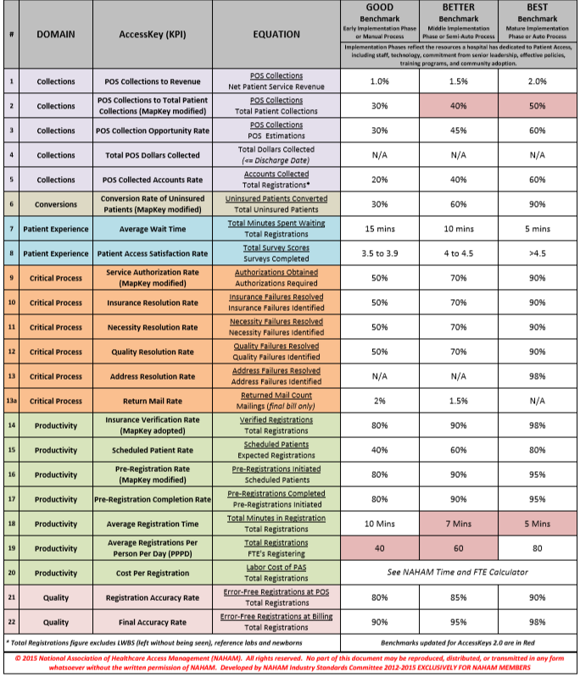
Measuring Success

Slide 21
Erica Franko
Senior Vice President and Managing Director, Advisory Services efranko@nthrive.com

