Slide 1
Reducing Registration Times with Patient Pass Check-In
Brett light, optimization director, Patient Access and financial clearance Services
blight@stanfordhealthcare.org
Stanford HealthCare

Slide 2
Program Overview
Business Case / Background
Objectives
Considerations
Implementation Recommendations
Workflow
Epic Tools / Build Information
Reporting
Staff Training and Preparation
Results
Lessons Learned

Slide 3
Developing the Business Case
Fundamentally this is about Compassion
Most multi-specialty and cancer centers across the nation have subspecialties and often see patients who have multiple appointments on the same day
For cancer centers, this can be 40% of all patients
According to the NIH, in 2018 over 1.7 million patients will be diagnosed with cancer in the U.S.
40% of 1.7 million = 680,000 new cancer patients can benefit from this each year
Additionally, many of these patients are seen several times a month
It is important to ask ourselves if our processes are compassionate
The chronically ill generally value their time as much as they value the best medical outcomes
Ultimately, current processes lack compassion when they require frequent return and multiple same day appointment patients to stand in a check-in line for each appointment and give the same information at multiple front desks

Slide 4
Business Case
Challenge
Streamline the registration process for patient satisfaction and their healing while supporting our clinical team requirements
Solution
Achieve our concept of one-stop registration for multiple encounters in the same day by streamlining workflows and optimizing technologies to consolidate various registration types and activities

Slide 5
Process Overview
3 Easy Steps:
Register the patient for all scheduled appointments in a single interaction with one registrar
At the end of the registration, the patient receives a barcoded Patient Pass for each service that day
Patient scans the Patient Pass at the arrival station located within each service area, which checks in the appointment
Step 1:
Register patient and provide a patient pass for all visits on same day
Step 2:
Patient Scans Patient Pass (prior to each subsequent visit)
Step 3:
Patient takes a seat

Slide 6
4 Objectives
Reduce the average patient registration time
Improve Press Ganey score for Courtesy of Registration Staff
Achieve high patient adoption rate
Ensure our Clinical team requirements are met with every patient

Slide 7
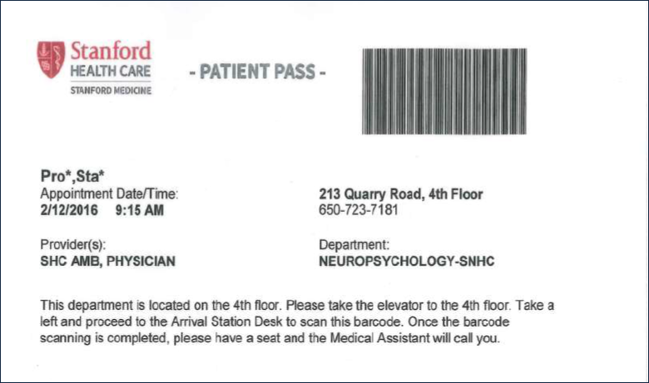
Patient Pass Project: 5 Key Steps
1. Address all patient and provider questions and secure clinical buy-in for the new process
2. Design Arrival Station locations for optimal patient flow (as patients exit elevators or between the entry door and the front desk)
3. Obtain the appropriate hardware
4. Determine check-in restrictions for Arrival Stations
Such as clinical department cut-off time for early or late arriving patients
5. Carefully design the Patient Pass

Slide 8
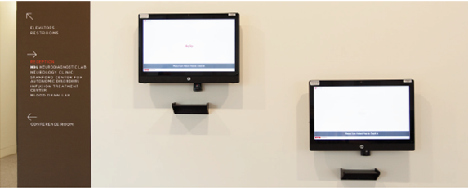
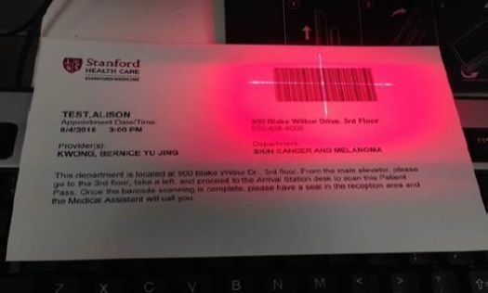
Universal Registration Patient Pass System
Patient Arrival Station
Patient Pass
Strategically located within the various floors/departments
Touch Screen with user friendly prompts
Scanning platform
Considerations: IT, Facilities Compliance, ADA, Interpretive Services
Truncated Patient Name
Appointment Date & Time
Appointment Location
Provider Name
Basic Instructions
Barcode
Note: A Patient Pass will be issued for each appointment

Slide 9
Elements of the Patient Pass
Document Title
Barcode
Company Logo
Patient Name, Appointment Date and Time
Department Address / Phone Number
Provider Name
Department Name
Instructions on location and use

Slide 10
Recommendations
Include Patient Advocacy in Design
By assuming we understand the patient needs we might miss a great opportunity to improve our project outcomes The importance of being able to state “this design is based on direct patient feedback”, can overcome the inertia that may come in the form of budgets, staff, and provider resistance

Slide 11
Recommendations
Align Requirements with Clinical Partners
How early can patients arrive?
How late can patients arrive?
Should we restrict patients from scanning too early or too late?
How do we want to respond when a patient tries to scan in the wrong service area or on the wrong floor?
The next illustration highlights what we were asking our IT partners to accomplish.

Slide 12
Workflow
Ellen arrives at the Neuroscience multi-specialty center for three appointments.
Physical Therapy at 8:00 A.M.
Radiology at 10:00 A.M.
Clinic visit at 11:00 A.M.
7:50 A.M.
Registration (all appointments)
Print Patient Passes
8:00 A.M.
Patient Scans pass at Arrival Station
9:00 A.M.
Notified: Too early!
PT appointment
9:15 A.M.
Patient scans pass at Radiology dept.
Radiology Team Notified of patient arrival
11:00 A.M.
Patient scans pass at clinic
Clinic visit
10:00 A.M.
Radiology Appt
PT Team Notified of patient arrival
Clinic team notified of patient arrival
Patient attempts to scan pass at Radiology dept.

Slide 13
Clinical Team Hand-Off
The Patient Pass is Collected by Clinical Staff Team Member
Shred any patient sensitive information, including the patient pass

Slide 14
New Patient Status
Scheduled: Service is scheduled but patient is not present yet
Present: Patient is present but not checked in yet (The patient is between registration and scanning the patient pass)
This tells the clinical staff that that patient is here but not available to be roomed yet
Arrived: Patient is present, has scanned their pass, and is checked-in for their appointment
This tells the clinical staff that the patient is here and they are checked-in and ready to be roomed

Slide 15
Build: 5 criteria you need the system to enable
1. Collect multiple payments during sign-in
New feature in Epic 2015
2. Print Patient Passes when patients sign in
Be sure to validate the patient Pass SmartText, print group, and report
Enable automatic printing
3. Enable Arrival Stations to scan Patient passes
Install Welcome, if not already present
Set up workstations only to scan passes and change appointment status to Arrived
Enable check-in barcode scanning
Prevent patients from scanning passes at the wrong place or time
4. Highlight rows on the DAR based on the patient’s appointment status
5. Track patient locations
On the DAR
On providers’ schedules
On Status Boards

Slide 16
Testing the Build
Be Sure To Validate The Following:
Multiple visit copayments can be collected from a single screen and generate one receipt
Patient Passes are printed when patients complete sign-in
Each Patient Pass contains the appropriate information for the patient's appointment
Arrival Stations scan barcodes and check in patients
Rows are highlighted on the Daily Activity Report (DAR) or Schedule for the clinical team as expected
Patient locations appear on the DAR, provider schedules, and Status Board as expected

Slide 17
Implementation Impact
Moderate
This project should take your organization's Cadence team about one to two months to implement If you need additional hardware, such as touchscreen monitors, printers, and barcode scanners Plan time to select, purchase, and install the new devices

Slide 18
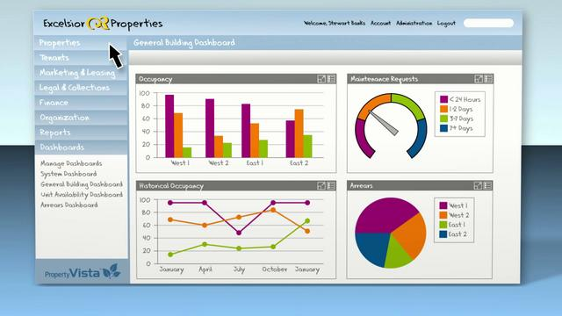
Reporting
Reporting Workbench template 1520-Registration Timing Report Template
Shows how long it takes registrars to complete registration for new and existing patients
Radar dashboard
16001-Reg Timing. This component gathers the registration timing data that is saved when users complete registrations for new and existing patients.
55061-ES Appointment Volume by Department and Status. This component shows the appointment volume for the user's reporting departments broken down by status.
78000-Welcome Check In Percentage. This component shows the percentage of check-ins that were completed at an arrival station.
11710000054-ES Copay Collection by Department. This component shows the copay collection rate for multiple departments over time

Slide 19
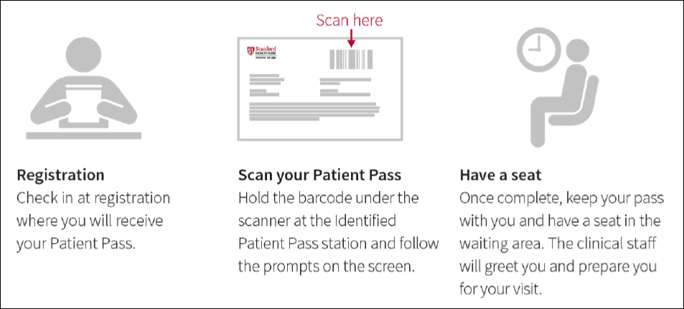
Training
Use resources to help guide patients through the workflow:

Slide 20
Training: 4 Important Considerations
1. Use a script to help prepare front desk staff to assist patients with using their passes:
2. Standardize the language (patient pass vs boarding pass, arrival station vs computer, etc.)
3. Conduct mock scenarios with scripted patients
4. Conduct mock role playing and testing sessions with registration staff prior to go-live
Goal | Registrar Response
Introduce the Patient Pass | "I have completed your registration. I am now going to hand you a Patient Pass(es), which you will need to scan at the arrival station to notify the clinic team that you are ready to be roomed for your next/additional appointment(s)."
Communicate | "This pass will allow us to serve you better as you will simply scan your pass at the patient arrival station at your appointment destination, press the Confirm button on the monitor, and have a seat in the lobby."
Ask | "Do you have any questions about your Patient Pass at this time? I can also provide you with this informational sheet should you like to read further about this tool or for your family members as well."

Slide 21
Results: Stanford Neurosciences Deployment
Average Registration Time (in Minutes) at Stanford Health Care
Key Facts and Figures
Universal Registration resulted in a 70% decrease in patient registration time, and a 57% decrease in staff registration workflow time
The Patient Pass adoption rate is 90%
Top Box 86.1%ile Press Ganey (from 79 before go-live)
No negative Press Ganey comment about Patient Pass
No physician Patient Pass related complaints

Slide 22
Patient Feedback: Stanford Neurosciences Deployment
It is good! Easy enough.
I think patient pass is nifty. I like because it is efficient. I’m very impressed.
My future appointments will be a piece of cake!
Very high tech!
This isn’t good for people with disabilities
I don’t like it because it makes me wait when I arrive too early. But when others arrive late it lets them scan and check-in while I’m still waiting and I got here way before them
Picture depicts patient using patient arrival station at Stanford Neuroscience Health Center
Notes:
For those patients that prefer the traditional method or aren’t confident they can use the system correctly, that’s perfectly OK – just arrive them manually.

Slide 23
Sharing Lessons Learned
It is critical to partner with your IT and Clinical teams through every phase of the project
For technology solutions with patient navigation, identify infrastructure requirements early in the process in the event these require building permits or facilities support
Expect resistance from within. To overcome this, consider:
Utilizing patient feedback to steer the implementation decisions
Using a smaller sized proof of concept (POC) first
Gathering data from the POC to guide decisions and provide context for moving forward

Slide 24
Questions?
Special Thanks to the following Stanford Healthcare Staff:
Anna Dapelo-Garcia, Administrative Director, PAS and PFC at Stanford Healthcare
Shannon Jamarck, PAS Manager - Neurosciences
Marvin Quant, Manager – Access: Cadence, Referrals, CRM
Premkumar Shanmugamani, Senior Systems Analyst, Access – Cadence, Referrals and CRM
Courtney McCrary, Senior Systems Analyst, Revenue Cycle Systems and Services
For more information contact Brett Light at:
blight@stanfordhealthcare.org
Stanford HealthCare
All rights reserved. This presentation or any portion thereof may not be reproduced or used in any manner whatsoever without the express written permission of Stanford Healthcare

