Slide 1
Survey Readiness
RIDEOUT HEALTH
Kimberly Black
Systems Director of Accreditation, Regulation, and Licensing and Compliance Investigations

Slide 2
Agenda
Key Topics:
Survey Scope
Initiatives to Stay CMS/CDPH Survey Ready
Monitoring/Auditing
Education
Lessons Learned

Slide 3
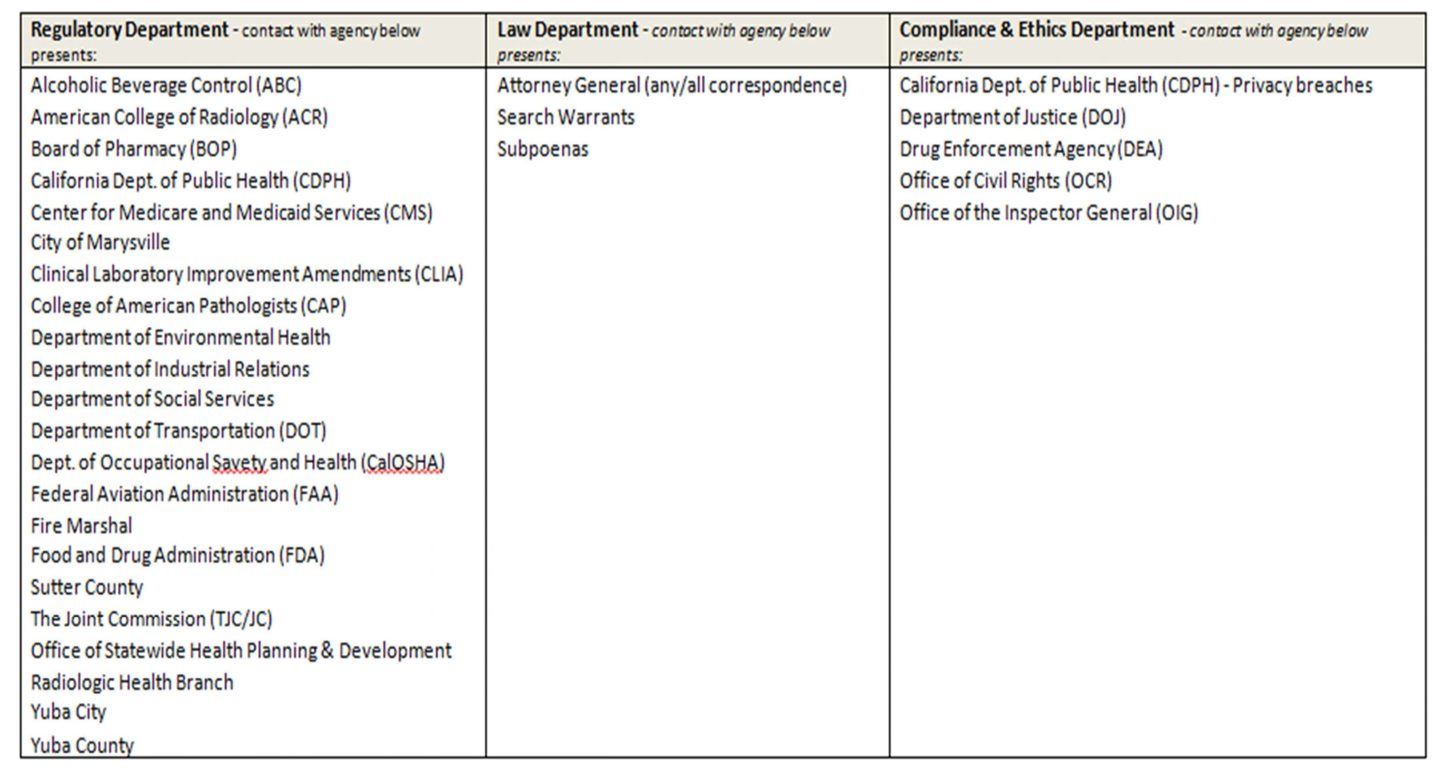
Survey Scope

Slide 4
Survey Scope Continued
Various laws and applicable requirements:
Title 22 – State Law
§70717. Admission, Transfer and Discharge Policies
CMS CoP’s – Federal Law
§482.12Governing Body, §482.24 Medical Records, etc.
Health and Safety Code
Section 1259 – Interpreter Services
Welfare and Institution Code
Section 19150-19154 – Interpreter Services
Notes:
Health & Safety Code, Section 1259(c)(2) which require hospitals to submit on an annual basis, a copy of their policy and procedures for providing language assistance services to patients with language or communication barriers to the California Department of Public Health(CDPH).
(4) Auxiliary aide services, such as reader services for individuals who are blind and interpreter services for individuals who are deaf. (5) Job coaching services that may include any of the following: (A) On-the-job skill training. (B) Observation or supervision at the worksite. (C) Consultation or training, or both, of coworkers an

Slide 5
Survey Scope Continued
Key Interpreter Service Requirements:
Policy Submitted to CDPH Annually
Signage
CHA For More Information
Availability of Interpreter Services
Look at for Consents
Paperwork available to key demographics
Look at for Patient Rights

Slide 6
Staying Survey Ready
Initiatives
Department Rounding
Auditing
Readiness Hour
Successful Tips
Relevant Information
Team Engagement
IT Partnership

Slide 7
Monitoring / Auditing
Auditing
Formalized approach, independent, and objective
Established approach for sampling
Effective for plans of correction
Monitoring
Day-to-day reviews
Approach may be informal
Implementing corrective action plans

Slide 8
Monitoring / Auditing Continued
Essentials
Understanding current workflow and processes
What happens, should happen, did happen
Ownership and accountability
Key is on the follow-up … resolution

Slide 9
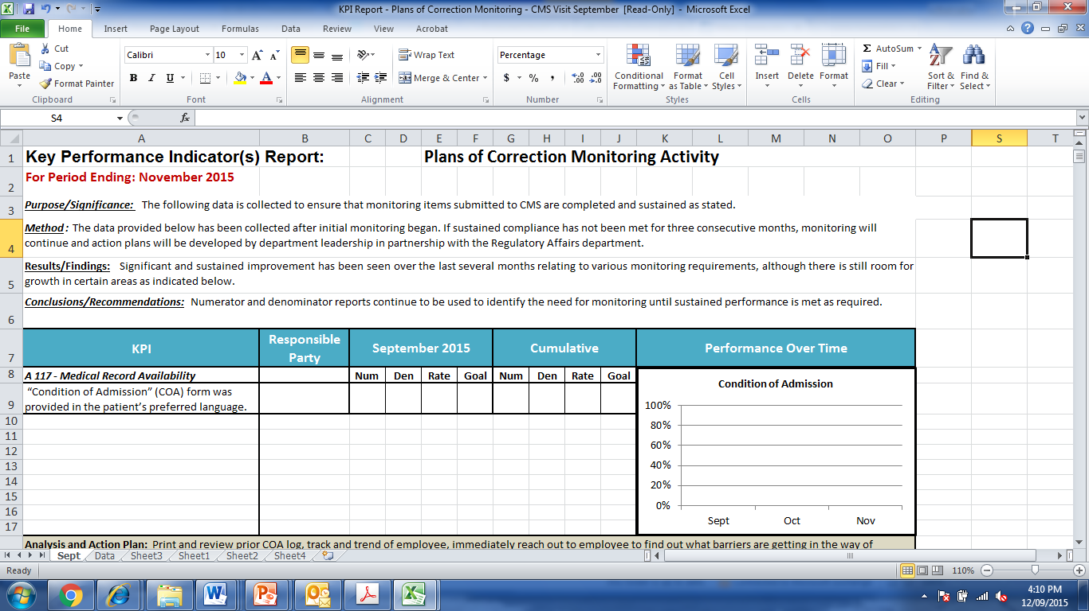
Monitoring / Auditing Continued

Slide 10
Education
Team Meetings
Agenda / Minutes
Sign-in Sheets
Staff Huddles
Email Correspondence
Read & Sign
How Are You
Documenting
Your Education?

Slide 11
Lessons Learned
Build regulatory requirements into your auditing tool.
Standardize your documentation.
Abbreviation list
Accountability
How do we maintain
And then what happened?

Slide 12
Questions /Comments?

